Slide 1
SPSP 2021 Webinar Series
Product Safety Management Best Practices:
Contracts and Product Safety
June 2, 2021
Sponsored by Sedgwick Brand Protection

Slide 2
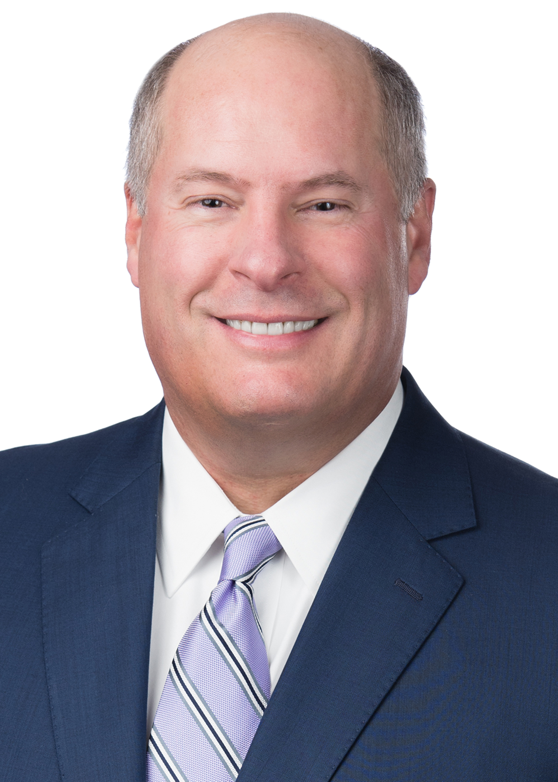
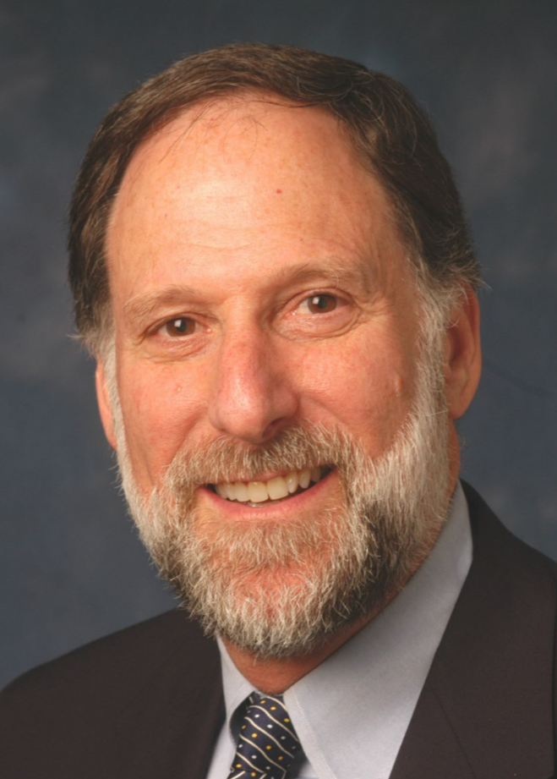
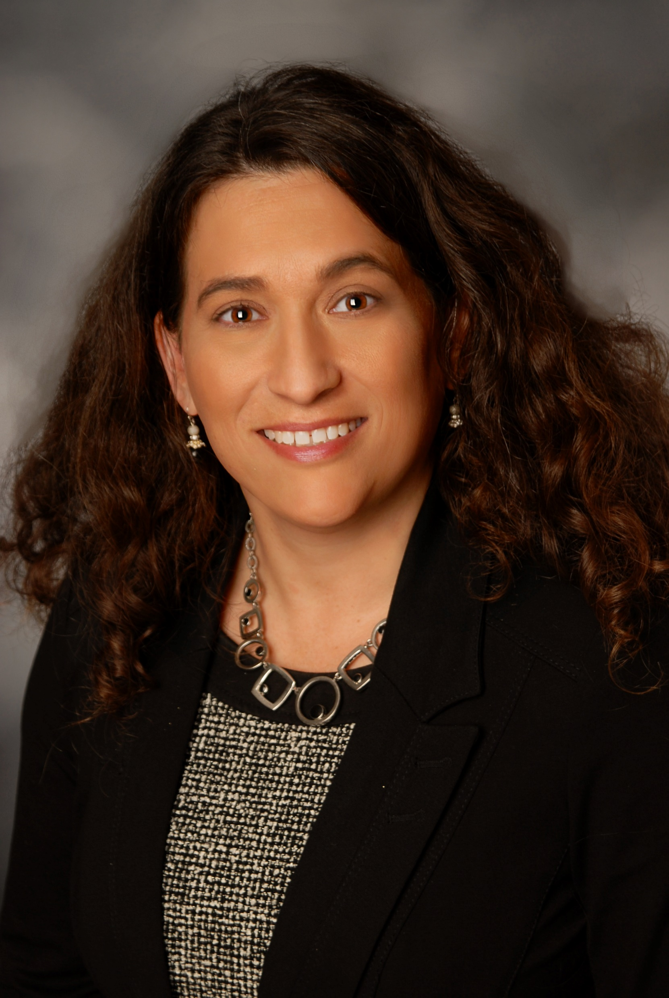
SPSP Webinar Speakers
John Kuppens
Partner
Nelson Mullins
Kenneth Ross
Of Counsel
Bowman and Brooke LLP
Heather Capell Bramble
Head of Regulatory Affairs and Retail Support Liaison, Mattel, Inc.
Notes:
KR will introduce the speakers and the subject

Slide 3
Chain of Production and Distribution
Product Safety Dept.
Product Manufacturer

Slide 4
Contracts - Chain of Production and Distribution
Material Supplier sells to Component Part and Final Product Manufacturer
CPM sells to Final Product Manufacturer and to Dist./Retailer
Manufacturer sells to Dist./Retailer
Retailer sells to Purchaser/User

Slide 5
TOPICS
Contract formation
Notes:
KR – introduce the topics we will discuss

Slide 6
TOPICS
Safety in contracts
Notes:
KR – introduce the topics we will discuss

Slide 7
TOPICS
Key elements of warranty
Notes:
KR – introduce the topics we will discuss

Slide 8
TOPICS
Compliance with standards
Notes:
KR – introduce the topics we will discuss

Slide 9
TOPICS
Recall costs
Notes:
KR – introduce the topics we will discuss

Slide 10
TOPICS
Indemnification
Notes:
KR – introduce the topics we will discuss

Slide 11
TOPICS
Investigate incidents
Notes:
KR – introduce the topics we will discuss

Slide 12
Questions?
For questions after the webinar or to post sample contract and safety information, email SPSP at info@productsafetyprofessionals.org
These slides, a link to this webinar and more contracts material can be accessed at SPSP website under “spsp-webinar-series”

Slide 13
Thank you for attending!
SPSP 2021 Webinar Series
June 2, 2021
Sponsored by Sedgwick Brand Protection
Notes:
Questions.
KR will ask questions and DM or JB can answer, depending on the question.

