Slide 1
SPSP 2022 Webinar Series
Recall Preparation (Part 2):
Plans and Insurance
April 14, 2022
1:00 – 2:00 p.m. ET
Sponsored by Sedgwick Brand Protection

Slide 2
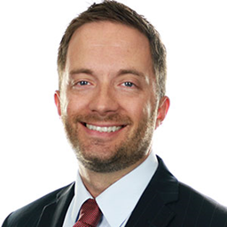
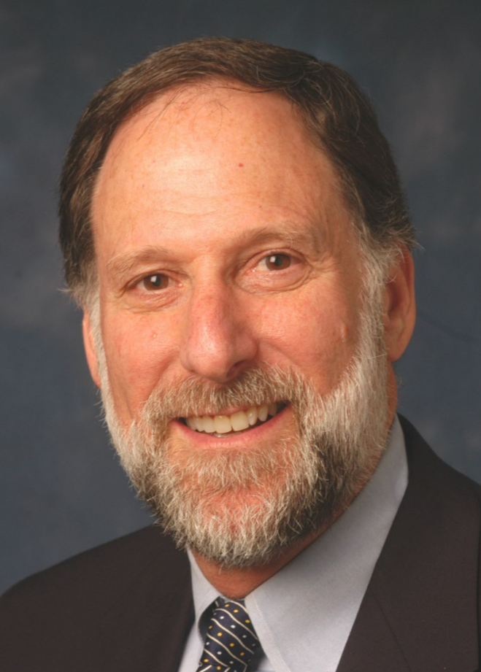
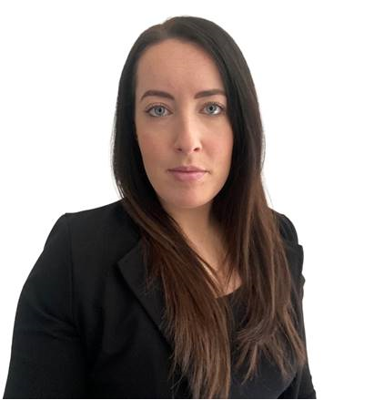
SPSP Webinar Speakers
Chris Harvey
Sedgwick Brand Protection
Kenneth Ross
Bowman and Brooke LLP
Amie Townsend
HISCOX Insurance
Notes:
KR will introduce the speakers and the subject

Slide 3
Topics
What is recall insurance, what does it cover, how is it different from CGL policies
Recall plans
How to create
What do they cover
How to implement
How to educate employees
How to gauge preparedness – mock recalls, etc.
What do insurance companies look for in recall plans and other ways companies should prepare for recalls

Slide 4
Topics
Recall Insurance

Slide 5
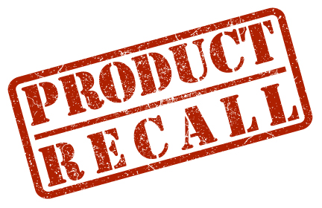
Product Recall Insurance
Safety triggered recall and government ordered recall policy for manufacturers and distributors. Has to have caused or is likely to cause bodily injury or property damage.
Protection for a company’s balance sheet and their brand
Designed to cover the first party costs related to a recall that are excluded in most liability covers
Access to crisis consultant expertise

Slide 6
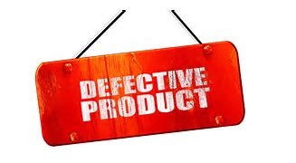
Product Recall Insurance
Basic triggers: Bodily Injury & Property Damage
Following an error in the manufacturing or design of a product
Product Defect
Government Recall
Malicious Product Tampering
Product Extortion
Third Party Loss
Costs covered:
Pre-Recall & Recall Costs
Business Interruption & Extra Expenses
Brand Rehabilitation Expenses
Extortion Costs
Consultants Costs

Slide 7
Recall vs Liability insurance
First party recall costs | Third party recall costs | Business interruption | Replacement costs | Rehabilitation expenses | Consultants costs
Limited. ($50k / $100k) |  |  |  | Not usually | Limited. No incident response
 |  |  |  |  | Unlimited costs
General / Property Liability
Product Recall

Slide 8
Topics
Recall Plans

Slide 9
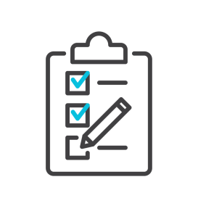
Who should have a recall plan?
Recall Plan

Slide 10
What is the biggest mistake companies make with their plan?

Slide 11
How do you create a recall plan?

Slide 12
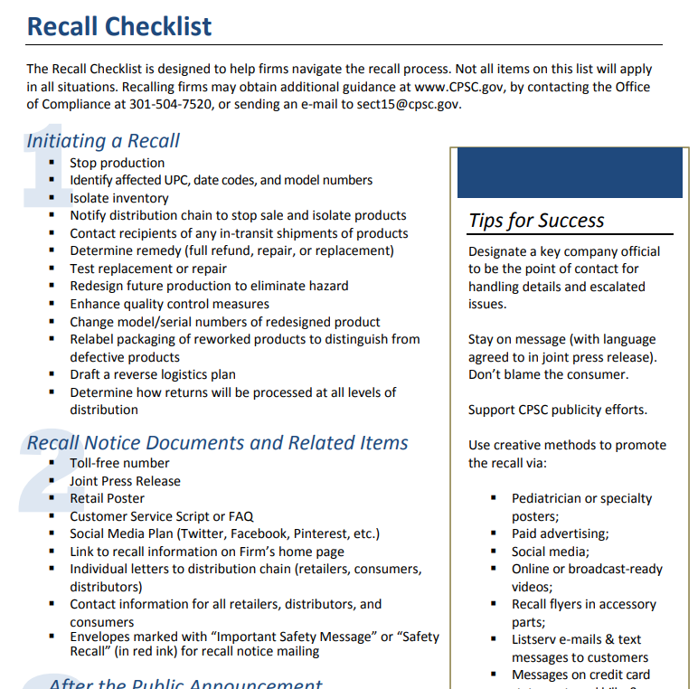
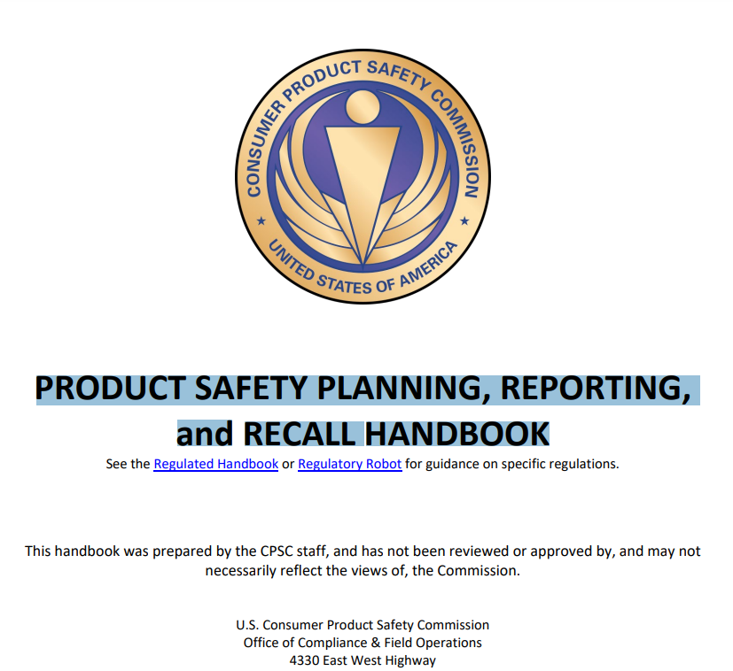
Designate a person to take lead on developing the plan.
Identify additional stakeholders to serve as primary contributors or support staff
Plan should be comprehensive based on your organizational type.
Consider both domestic and international distribution
Use available resources

Slide 13
Table of Contents (Draft)
Purpose
Scope
Definitions
Recall Team
Roles and Responsibilities
Investigating a Potential Safety Hazard
Decision to Recall
Regulatory Reporting
Determine Scope
Recall Execution/Strategy
Remedy
Recall Communications
Response Management
Recall Logistics
Outside Partners
Execution Reporting and Effectiveness
Recall Termination
Post Recall Lessons

Slide 14
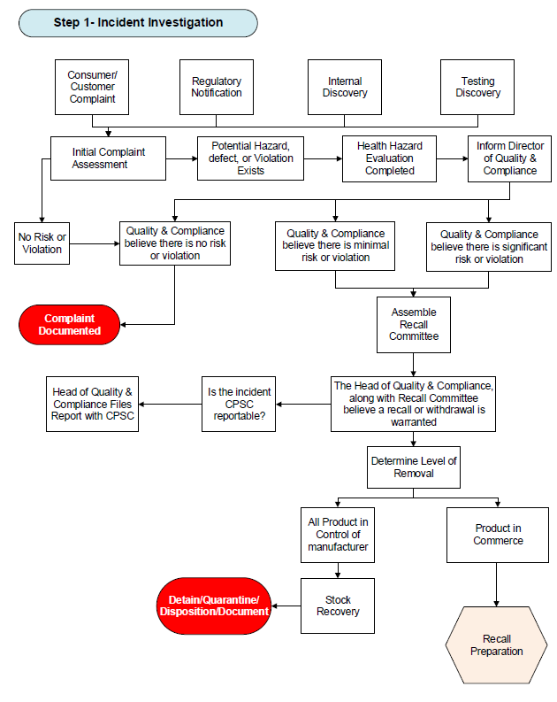
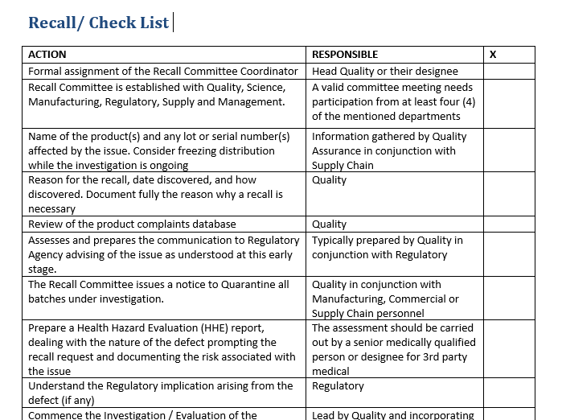
Appendixes
Recall Process Flow
Recall Links
Check Lists
Responsibility Matrix
Consumer and Customer Recall Letter Template
Press Release Template
Progress Report Template
Recall Scope Worksheet
Hazard Assessment
Sample Retailer Poster

Slide 15
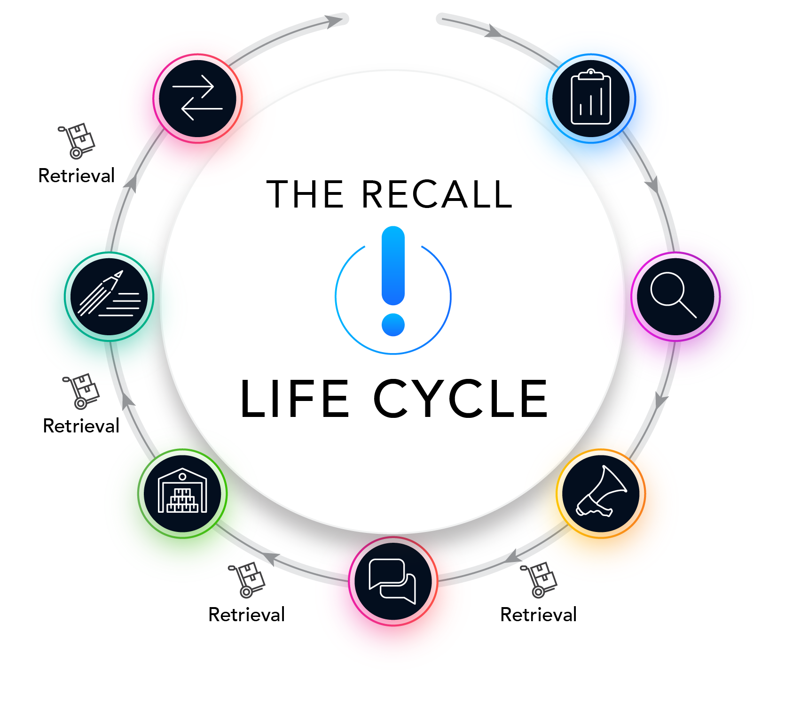
Recall Lifecycle
Resolution management
Preparation
Remedy management
Customer/Consumer
Identification
Product processing
Notification management
Response management

Slide 16
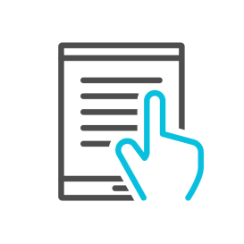
You have a robust recall plan, what is next?
Training
Mock Simulations

Slide 17
Topics
What insurance companies look for in
recall preparation

Slide 18
What insurance companies look for in recall preparation
Recall plan
Crisis management plan
Batch coding / traceability
Subrogation rights
Regular staff training

Slide 19
For questions after the webinar, email SPSP at info@productsafetyprofessionals.org or contact speakers:
Chris.Harvey@Sedgwick.com
Amie.Townsend@HISCOX.com
kenrossesq@gmail.com
These slides, a link to this webinar and more recall material can be accessed at the SPSP website under “SPSP-webinar-series.”

Slide 20
Thank you for attending!
SPSP 2022 Webinar Series
April 14, 2022
Sponsored by Sedgwick Brand Protection
Notes:
Questions.
KR will ask questions and DM or JB can answer, depending on the question.

