Slide 1

SPSP 2024 Webinar Series- Sponsored by Sedgwick Brand Protection
Lindsay Lorimer and Rachel Cooper

Slide 2
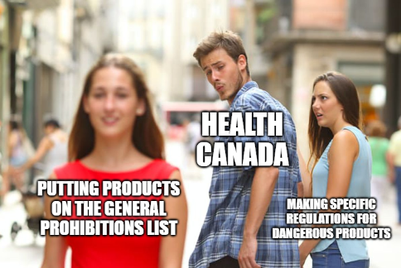
General Prohibitions and the general prohibition list
Manufacturer and importers prohibited from manufacturing, importing, advertising or selling
Any person prohibited from knowingly advertising or selling a consumer product that
    is a danger to human health or safety;
    is the subject of a recall order, or is the subject of a voluntary recall in Canada because the product is a danger to human health or safety; or
    is the subject of a measure that was
    ordered to be carried out, but wasn’t

Slide 3
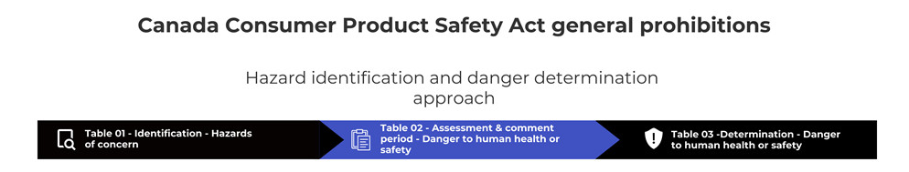
General Prohibition List Process

Slide 4
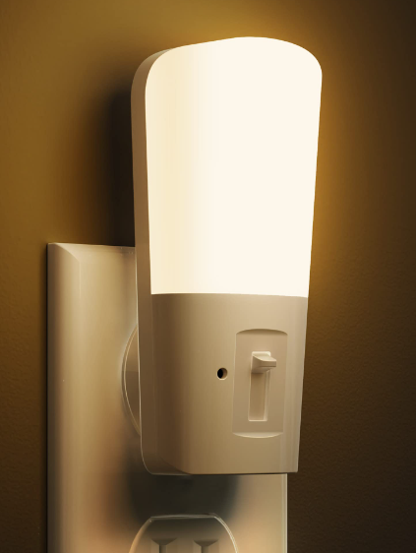
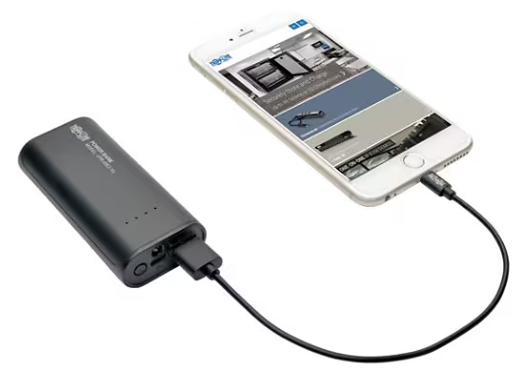
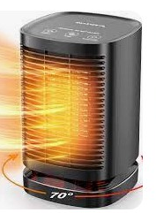

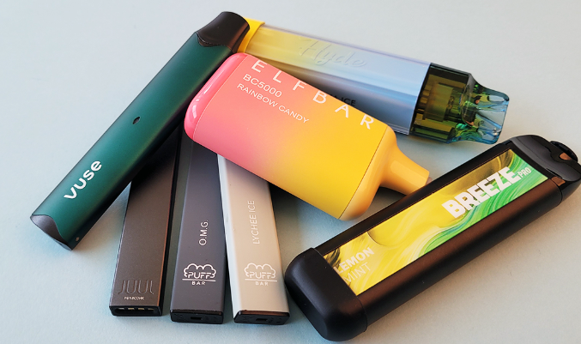

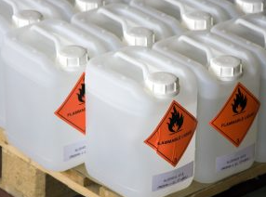
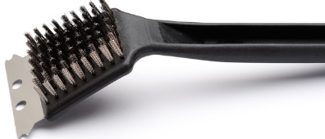
General Prohibitions List – Table 1 Identification of hazards of concern
Not pictured: products containing button batteries, toys with lasers, portable fuel burning generators.

Slide 5
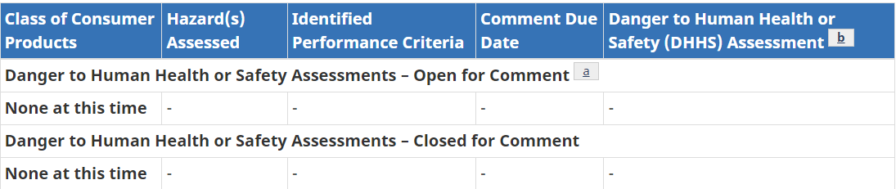
General Prohibitions List – Table 2 Open for comment for danger to human health or safety assessments

Slide 6


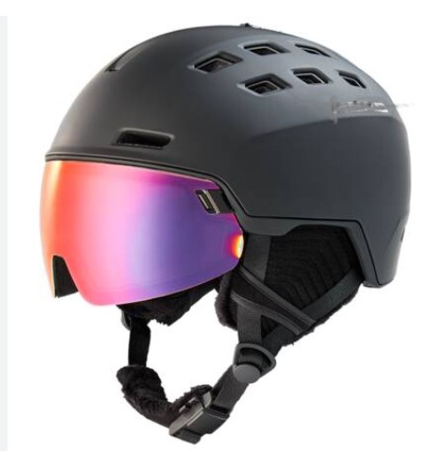

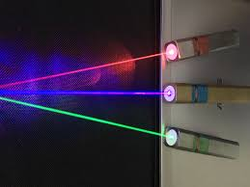
General Prohibitions List – Table 3 Determination of dangers to human health or safety
Not pictured: containers of pourable alcohol-based fuels, portable firepots that use pourable fuels

Slide 7


Reporting in general – Canada versus US
Health Canada expects more reporting than the CPSC in the US
However, likelihood of product action being required is also lower in Canada.
Reportable Incident in Canada not necessarily reportable in US (will CPSC agree?)
Problem that triggers 15(b) report in US likely reportable in Canada.

Slide 8
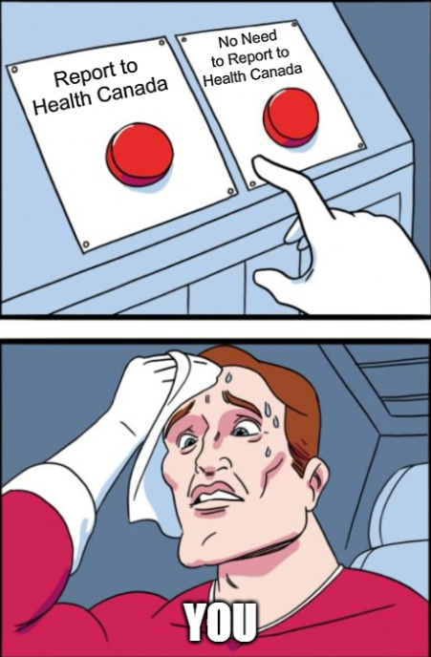
Mandatory Incident Reporting

Slide 9
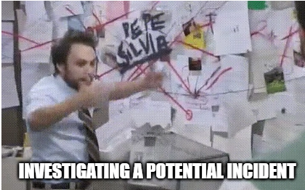
Interpretation Points - When Do You Become “Aware” of an “Incident”?
First you determine (i) whether an event is "related" to a consumer product that you manufacture, import or sell in Canada and (ii) that the event is an Incident;
Then you become "aware" of an Incident and the 2-day and 10-day reporting timelines start to run.

Slide 10

Interpretation Points (cont’d) – “Awareness”
Information about an Incident may come directly from consumers (reports, complaints or lawsuits).
Per Health Canada, other possible sources include:
    Information received from governments, standards bodies, suppliers, customers, NGOs;
    Reports from experts, test reports, studies;
    Any other direct notification with enough detail for evaluation.

Slide 11

Threshold to report- has there been an “Incident”?
An “Incident” is…
    an occurrence in Canada or elsewhere;
    a defect or characteristic; or
    incorrect or insufficient product information that resulted, or may reasonably have been expected to result, in death or in serious adverse effects on health, including serious injury.
An Incident also includes…a recall initiated (anywhere) for health
or safety reasons.
Incidents can include normal or foreseeable use or misuse.

Slide 12

What constitutes a serious health risk or injury?
Examples:
threats to breathing
serious burn or cut
internal bleeding, injury to an organ, broken bones
poisoning
allergic reactions (including anaphylaxis)
loss of consciousness
convulsions
loss of sight or hearing

Slide 13
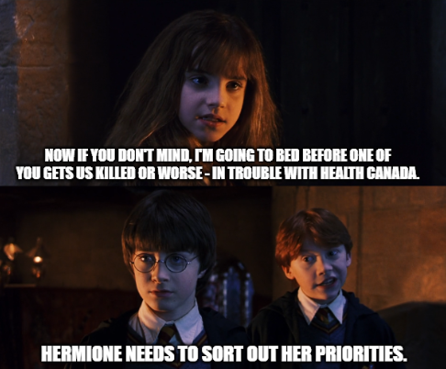
Examples of Prioritization Considerations
Severity of injury
“Near-miss” significance
Victim age; target age for product
Product factors (e.g. new/used)
Product and industry history
Usage of product
Risk issue consideration (media attention, product attention, jurisdiction, etc.)

Slide 14

What Level of Inquiry is Required?
Little to no guidance on what level of investigation is required
Duty to report not avoided by insufficient or inadequate inquiry to permit a conclusion
Do you have time to investigate?
  Yes, investigation can be undertaken before timelines start to run
  BUT no guidance on what amount of time is reasonable

Slide 15
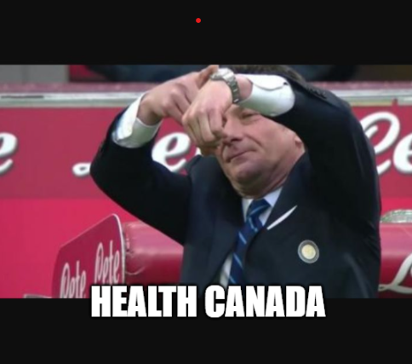
Two-Day Reporting Requirement
Within two days of awareness, an Incident must be reported to:
  Health Canada; and
  the person from whom you got the product.
All levels must report regardless of who has already reported. Health Canada expects multiple reports - the manufacturer, importer and seller all must report.

Slide 16
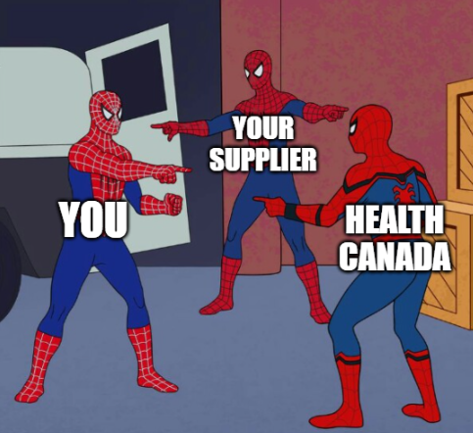
Must You Report if Someone Else Already Has?
Yes! Health Canada is relying on multiple reports to ensure all incidents and details are captured
If you do not report and if someone else in the supply chain has, Health Canada will want to close the loop

Slide 17

The Ten-Day Requirement in Practice
Within ten days of awareness of an Incident, manufacturers or importers must submit a written report (on-line form) to Health Canada.
Same form (and HC case number) as Two-Day report, but must contain information about:
    the product involved;
    other products that could be involved in a similar incident; and
    any proposed countermeasures
    Focus will be on sections 4, 6 and 7 of the form

Slide 18
Considerations
If your competitors are reporting on a similar product and you are not, Health Canada will suspect under-reporting
If your first report is a combined two and ten-day report, Health Canada will question whether your two-day report was timely
If 10 days is not sufficient to reach conclusions, extension can be requested
If company is awaiting CPSC approval of corrective action plan, that should be reported

Slide 19
Evaluated not an Incident [“ENI”]
Section 1 of the on-line reporting form allows for submission of a report as a mere notification where an event has been evaluated as “not an Incident”.
Used where consumers or retailers file incident reports and the manufacturer or importer does not believe the event is a reportable Incident.
Also used where a company does not believe there has been a reportable incident but wants to report out of an abundance of caution because of specific consumer reports or because they have reported to the CPSC.

Slide 20
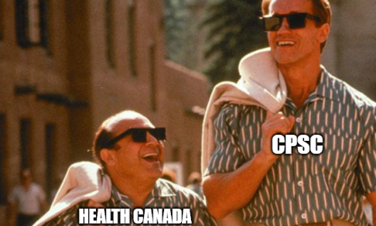
Can/should you use the S. 15 CPSC Report to report to HC?
Generally, meets content requirements but must be supplemented with Canadian specific data
But will this compromise the U.S. confidentiality protection for the report?
Will be exposed to Canadian Access to Information Act

Slide 21

CCPSA/CPSA Reporting - Timing Issues
You will likely have to file the Ten-Day report before finalizing with the CPSC
re “corrective measures” - indicate you are working with CPSC and planning to implement the same program in Canada
If working with another agency (ESA, TSSA), advise Health Canada of this

Slide 22

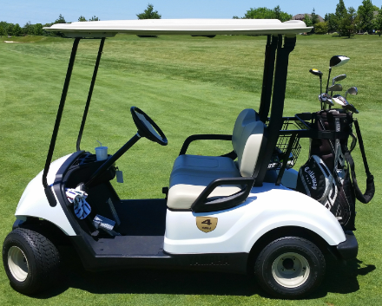
Mind the Gap – Regulatory oversight of e-bikes and golf carts

Slide 23

Best practices where there is a regulatory gap
Some products are regulated by the CPSC in the US but are regulated by Transport Canada in Canada
  Restricted use vehicles
If regulator claims product/vehicle falls outside their purview report anyways
  Transport Canada
  Health Canada
  Electrical Safety Authority
  TSSA

Slide 24
Benefits of recalls
Courts in Ontario have held that a well-designed recall is preferable to class action in economic loss claims (Bowman v. Kimberly Clark (Flushable wipes), Coles v. Chrsyler (air bags), Burr v. Tecumseh (heat recovery ventilators), Richardson v. Samsung (cellphones)
The recall should be initiated quickly and take an expansive approach
Companies should work with regulators
An effective recall should comprise of a repair, refund or replacement and the process should be user friendly
Robust notification (social media, direct mail, website, text) is a consideration

Slide 25
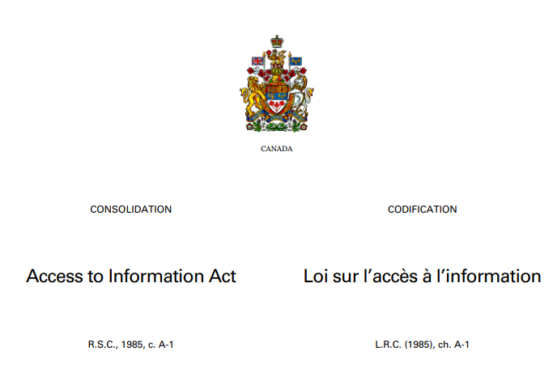
Other Reporting Considerations
Health Canada wants to hear from you early and often – they want a dialogue, not one-time reporting
Advise Health Canada if you are working with other agencies ESA, TSSA – dual reporting not always necessary
Confidentiality - incident reports and attachments are not exempt from disclosure under the Access to Information Act

Slide 26
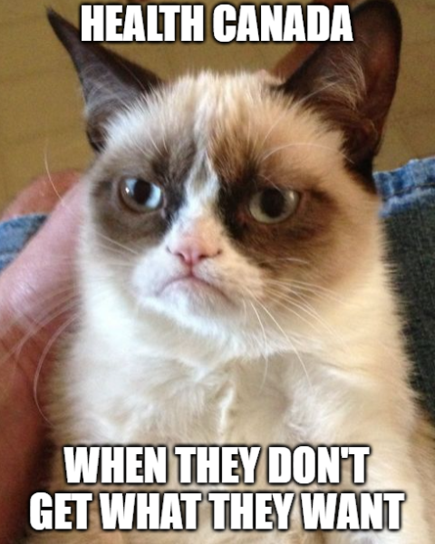
Health Canada’s Current Complaints
Health Canada’s main complaints
    under-reporting – this and low population (relative to US) makes it difficult to identify trends – they want OVER reporting for now to address this
    timing requirements not met; and
    interpretation of “does the event indicate an unreasonable hazard” by industry has been too technical – perspective should be that of a consumer.

Slide 27

What Happens When You Submit a Report?
Health Canada case number and submission number assigned (case number to be given to the supplier and used for any subsequent reports)
Health Canada’s “Triage” approach
    Entry of report into HC system
    Administrative screening of report
    Prioritization of report
    Report sent to group best placed to
    take action
    Proposed mitigation/corrective/other
    measures considered (if necessary)

Slide 28


Not Every Report Will Generate a Response to the Reporter
Health Canada will not respond to every report – “silence” is good news though there is no deadline for their response which can create uncertainty.
The triage system is focused on “high risk” events.
Reports may simply be used to collect information about emerging trends and how consumers are interacting with products.
Health Canada less likely to intervene where company is known to have a robust field data evaluation program

Slide 29

Inspections and Audits

Slide 30
Compliance Inspections
Recent inspection campaigns focused on compliance with s. 14 (mandatory reporting)
HC is focused on
  CCPSA related internal roles, responsibilities & training
  processes & record-keeping related to purchasing
  what is done to ensure regulatory compliance, product traceability,
  handling consumer complaints,
  what means the company has to learn about product issues

Slide 31
Compliance Inspections
Process:
  supposed to be "no jeopardy" situation
  list of questions sent in advance
  documents requested in advance
  need to have relevant people & records available on site the day of the inspection
  HC will want to meet with relevant people, ask questions, review documents
  a detailed HC letter follows assessing you and saying what you need to do
  IMPORTANT TO PREPARE LIKE YOU WOULD FOR A DEPOSITION

Slide 33


Rachel Cooper
Lindsay Lorimer
Product Liability
Product Liability
Toronto, Canada
Toronto, Canada
416.865.5543
416.865-7197
rachel.cooper@mcmillan.ca
lindsay.lorimer@mcmillan.ca

