Slide 1
SPSP 2024 Webinar Series
Product Sourcing & Contracting Overseas to Reduce Product Liability and Product Safety Risks
March 20, 2024
1:00 – 2:00 p.m. ET
Sponsored by Sedgwick Brand Protection

Slide 2
SPSP Webinar Speakers
Dan Harris – Partner, Harris Sliwoski LLP
Kenneth Ross – Of Counsel, Bowman and Brooke LLP

Slide 3
Different scenarios
U.S. Manufacturer (USM) specifies product. Foreign Manufacturer (FM) designs and manufactures it. USM is importer and could be licensor if FM puts USM’s name on product. USM may or may not approve finished product.
USM designs product. FM manufactures it. USM is licensor if FM puts USM’s name on product. USM may or may not approve finished product.
USM specifies and buys component from FM who designs and manufactures it.
USM buys component from FM who manufactures based on USM design/specs.

Slide 4
PRODUCT SOURCING & CONTRACTING
TO REDUCE PRODUCT LIABILITY RISKS
DAN HARRIS

Slide 5
THREE KEYS
Good Partnership
Good Contracts
Good QC

Slide 6
GOOD DUE DILIGENCE
Distrust all company info
Look around, ask around
Scrutinize the paper
Delegate. Do not delegate.

Slide 7
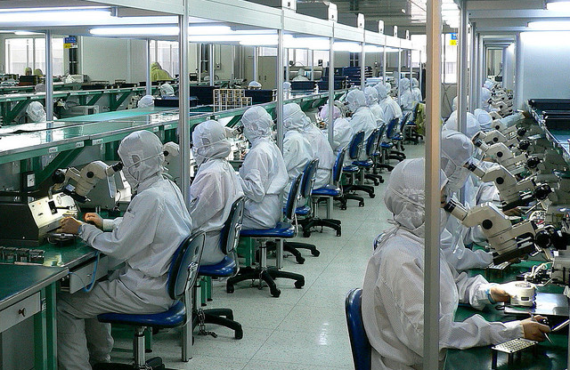
WEBSITE

Slide 8
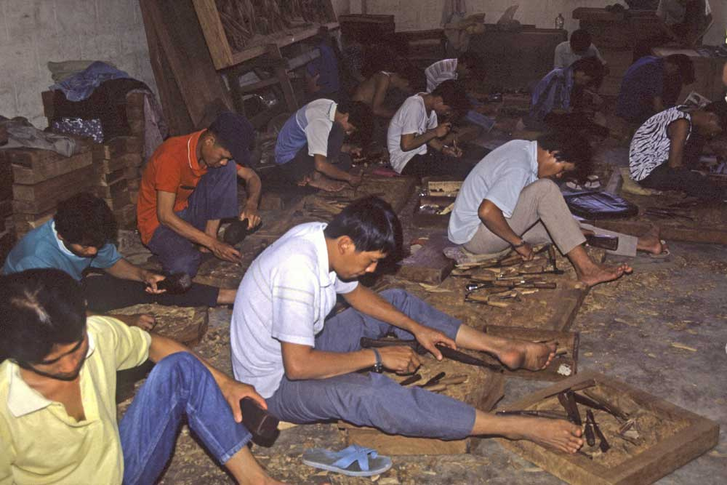
REAL LIFE

Slide 9
Make Your Manufacturer Your Friend
Visit manufacturer's facilities and meet with its management and affirm your need for quality and safety.
Develop a relationship with your manufacturer and work with them to ensure your products meet your standards.
Invest in quality control and testing.

Slide 10
DEAL/CONTRACT
Structure your deal and write your contract so your partner believes it will make more money with you than without you

Slide 11
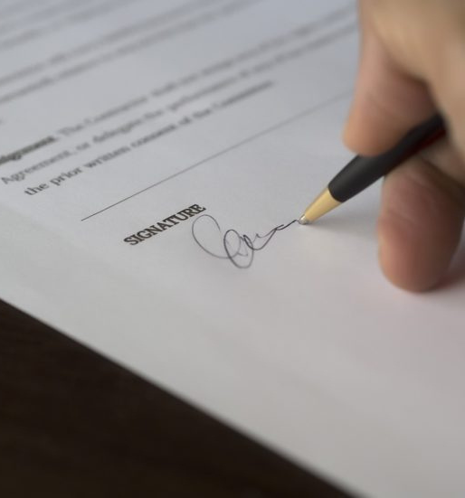
COMMON MANUFACTURING CONTRACTS
NNN
Product Development
Product Ownership
Manufacturing

Slide 12
WHY BOTHER WITH A CONTRACT?
Clarity
Enforcement
Prevention

Slide 13
WHY BOTHER WITH A CONTRACT?
What about corruption?

Slide 14
The Good Contract
Includes provisions for quality control, factory inspections, product testing, and liability.
Requires manufacturer obtain insurance to cover any product claims. MAYBE.
Is clear about subcontracting.

Slide 15
HOPE vs. REALITY
Product Liability Insurance
Indemnification

Slide 16
THE GOOD CONTRACT: GUIDELINES
In writing
One language
Excruciating detail
Sealed

Slide 17
THE GOOD CONTRACT IS WITH
THE RIGHT PARTY

Slide 18
THE GOOD CONTRACT
THINK…
LIQUIDATED DAMAGES
DISPUTE RESOLUTION

Slide 19
LITIGATING OUTSIDE CHINA
Chinese courts are not obligated to enforce U.S. judgments…
and they don’t.

Slide 20
LITIGATING OUTSIDE CHINA
Chinese courts are obligated to enforce Spanish judgments…
and they don’t.

Slide 21
ARBITRATING OUTSIDE CHINA
THINK ABOUT…
Hong Kong, Singapore, Vancouver, London, New York…
China does not recognize ad hoc arbitrations (HK Exception?)
Enforcement in China per New York Convention: “Getting better…”

Slide 22
CIETAC ARBITRATION CLAUSE
Specify…
English language
Non-Chinese arbitrator, or two or three

Slide 23
OVERSEAS FACTORY VISIT AS PRODUCT LAWSUIT PREVENTION
Strengthens Relationships
Helps with Quality Assurance
Gives Greater Understanding of Your Production Chain
Ethical and Customs Protections

Slide 24
GOOD QC
Just Do It

Slide 25
THANK YOU!
Dan Harris
dan@harris-sliwoski.com
China | United States | Spain

Slide 26
Issues
Design
Does USM review and approve?
Should USM provide clear specs?
Does supplier do typical hazard analysis, risk assessment and safety evaluations? Is it documented in English? Do you review?
Is product certified by NRTL? Does it comply with standards? Does it exceed standards?
Do you audit compliance and insist on no changes w/o approval
Manufacturing
Quality testing by FM and subtiers
Quality testing by USM
How does USM monitor quality – U.S. or in plant

Slide 27
Issues
Warnings and Instructions
Does USM review and approve or revise?
Should you require FM to use competent U.S. people?
Does USM recommend that hazard be designed out instead of warned about?
Do you review and revise warnings and instructions for components?

Slide 28
Issues
Post-sale
Does FM understand legal and regulatory requirements in U.S. and elsewhere for reporting and fixing safety issues?
Do they receive advice from competent U.S. people?
Will FM notify USM if they have problem with product sold to other OEM or to other importer?
Can FM trace defective product and narrow scope of recall?

Slide 29
Issues
Documents
Does FM document its processes and procedures? Are they in English?
Do they send key docs to USM?
Does FM keep its documents long enough so they are accessible to defend case or respond to Feds?

Slide 30
Issues
Defending case
Do they have people who can come to U.S. and testify? Are they any good?
Do they create and keep English language documents helpful to defend USM?
Can they be sued in U.S.?
Will they cooperate and coordinate with defense counsel?
If they indemnify you, will you be allowed to participate in defense?
Who decides on settlement or trial?

Slide 31
Lawyer Assistance
Help client decide initially if good idea for component or product to be purchased from foreign supplier. Is part or product safety critical?
Help to predict whether the component or product will create an actual problem. What happens if there is?
Help the business understand the risks and minimize them to the extent desired and possible through contract, insurance, etc.
Help decide when not to contract with a certain foreign supplier.

Slide 32
For questions after the webinar, email SPSP at info@productsafetyprofessionals.org or contact speakers:
dan@harris-sliwoski.com
kenrossesq@gmail.com
These slides, a link to a video of this webinar and more material can be accessed at https://www.productsafetyprofessionals.org/webinar-archive.

Slide 33
Thank you for attending!
SPSP 2024 Webinar Series
March 20, 2024
Sponsored by Sedgwick Brand Protection
Notes:
Questions.
KR will ask questions and DM or JB can answer, depending on the question.

