Slide 1

SPSP 2022 Webinar Series
2022 CPSC Update
January 12, 2022
1:00 – 2:15 p.m. EST
Sponsored by Sedgwick Brand Protection

Slide 2
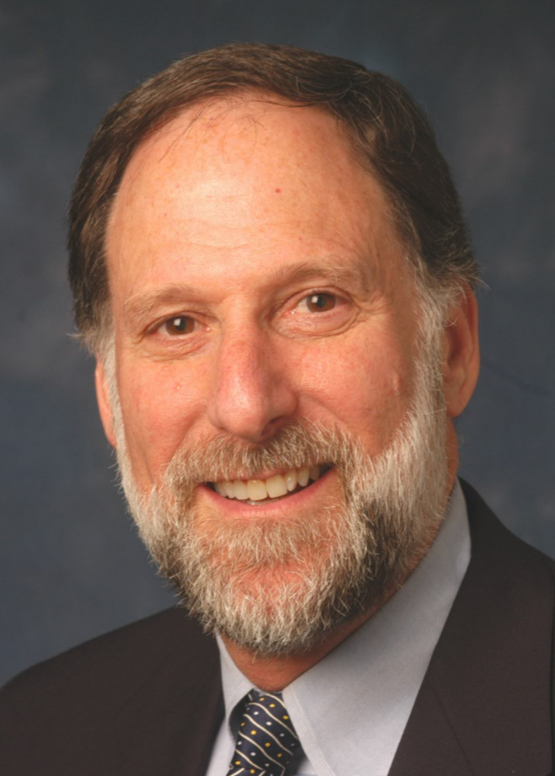
SPSP Webinar Speakers
Michelle Gillice
Arnold & Porter
Kenneth Ross
Bowman and Brooke LLP
Mike Gentine
Keller & Heckman
Boaz Green
Neal Cohen Law
Notes:
KR will introduce the speakers and the subject

Slide 3
Agenda
Organization changes
Compliance – Corrective Actions
Compliance – Penalties and other enforcement
Rulemaking and legislation
Questions
Notes:
KR

Slide 4
For questions after the webinar, email SPSP at info@productsafetyprofessionals.org or contact speakers:
    Michelle.Gillice@arnoldporter.com
    boaz@nealcohenlaw.com
    gentine@khlaw.com
These slides, a link to this webinar and more recall preparation material can be accessed at the SPSP website under “spsp-webinar-series.”

Slide 5
Thank you for attending!
SPSP 2022 Webinar Series
January 12, 2022
Sponsored by Sedgwick Brand Protection
Notes:
Questions.
KR will ask questions and DM or JB can answer, depending on the question.

