Slide 1

SPSP 2022 Webinar Series
Standards Development and Compliance
March 16, 2022
1:00 – 2:00 p.m. ET
Sponsored by Sedgwick Brand Protection

Slide 2
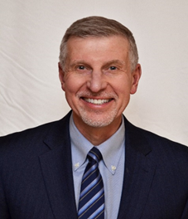
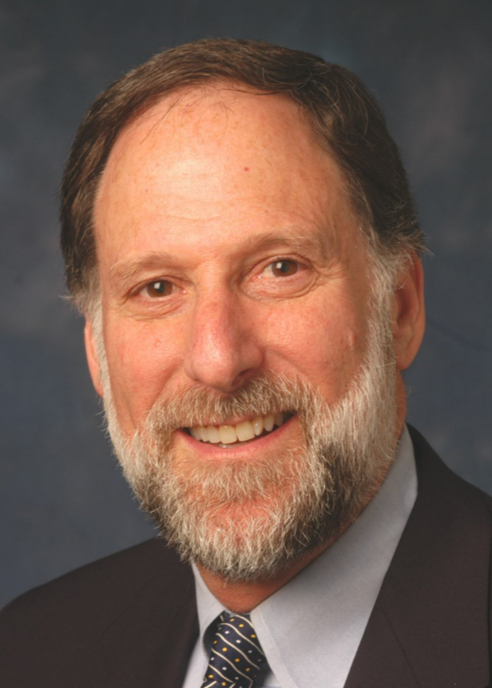
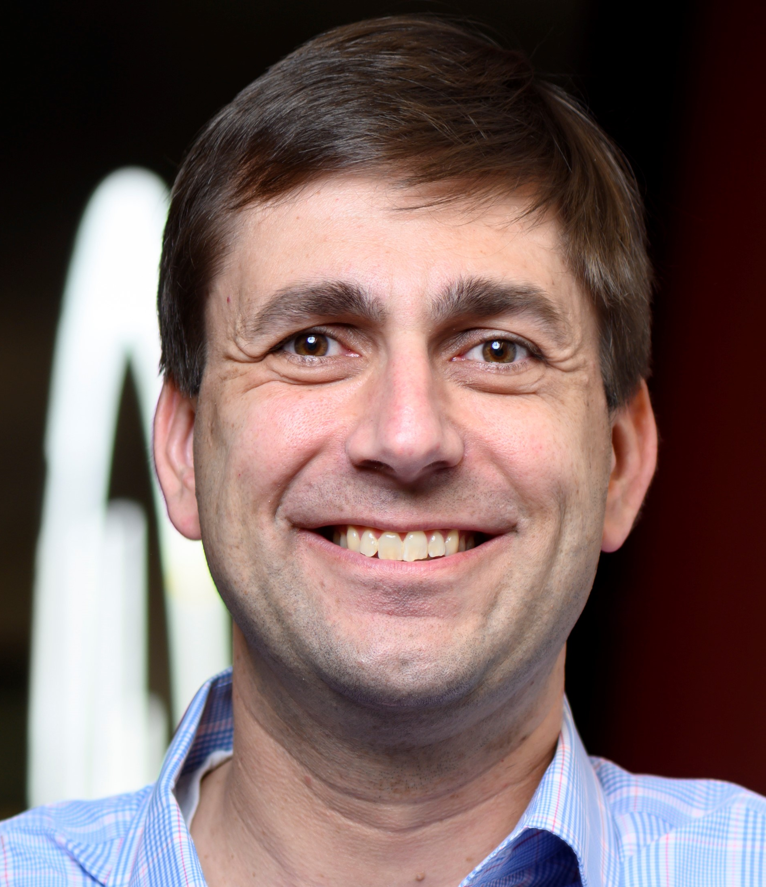
SPSP Webinar Speakers
Don Mays
Product Safety Insights LLC
Kenneth Ross
Bowman and Brooke LLP
George Borlase
Underwriters Laboratories
Notes:
KR will introduce the speakers and the subject

Slide 3

Interrelationship between three areas of analysis
Product Liability
Product Safety
Regulatory and Standards Compliance
Notes:
DM

Slide 4

Legal Requirements and Their Effect
Laws, regulations and standards that have been enacted by or adopted by governments
    Mandatory and must be complied with. Failure to do so might require that the manufacturer report non-compliance to a government agency who may require that the product be recalled. Non-compliance can be used to argue that the product is defective and violates the law.
    Compliance may not protect manufacturer in a product liability case. Jury might rule that the manufacturer should have exceeded laws, regulations, and standards.
    Plaintiff needs to prove that product should have been made safer and that failure to do so proximately caused the injury.

Slide 5
Legal Requirements and Their Effect
Voluntary consensus standards adopted by standards development organizations
    Compliance is voluntary unless adopted by government.
    Compliance may not protect manufacturer in product liability case, even if all products have the same level of safety.
    Non-compliance can be used to argue that product could have and should have been made safer especially if competitors comply and have a safer product.
    Plaintiff needs to prove that product’s failure to comply with standard proximately caused the injury (i.e., if product had been safer, accident would not have happened.

Slide 6


ASTM International
12,800+ consensus standards
30,000 volunteer members
Supports fair global trading
Helps ensure safety, quality, and reliability
Includes standards for water, petroleum products, amusement rides, autonomous vehicles, cannabis, consumer products, etc.
F15 Consumer Products
Established in ‘73 at request of CPSC
106 consensus standards
63 sub-committees
1000+ volunteer members
Includes standards for toys, juvenile products, lighters, scooters, and furniture safety
Some incorporated by reference in CPSC regulations

Slide 7
ASTM Process
Equal Voice, Equal Vote
Openness
Consensus based
Balance between Producers and Users/ Consumers /General Interest
One official vote per “voting Interest”
But all members can vote
All negatives are addressed
User, Consumer,
General Interest
Producer
ASTM
Technical Committees are balanced.
Notes:
Further distinguishing the ASTM standards development process is its fair and balanced voting process. Simply stated, at ASTM International, all members have an equal vote and equal voice in the development of technical standards. Fairness is further ensured through balanced participation among producers, users, general interest and consumer members of an ASTM standards writing committee.
Openness, transparency and a balanced, consensus process are the hallmarks of the ASTM system and have contributed to the quality, integrity and worldwide acceptance of ASTM standards for over 110 years.

Slide 8



Membership on our Standards Technical Panels represents
International membership on UL STPs
WE PROVIDE:
30+
~20%
Online collaboration platform
Unlimited free digital view of UL Standards
Adherence to WTO TBT principles
Virtual standards development meetings
COUNTRIES
OF TOTAL
3800+
UL Standards has local staff based in:
USA, ASEAN, CANADA, CHINA, DENMARK, INDIA & MEXICO.
Nearly 120 years of experience in standards development
INDIVIDUALS SERVE ON UL STANDARDS TECHNICAL PANELS FROM AROUND THE WORLD
Our GLOBAL PARTNERSHIPS are demonstrated via:
We have published more than
45
MOUs
1,700
Agreements with 22 countries and 2 regions
IEC, ISO, ANSI and SCC leadership roles
Convening of roundtables and other events
documents including standards, outlines
of investigation and design guidelines

Slide 9
Phases of the process
_ _ _ _ _
_ _ _ __
_ _ _ _ _
Proposal Submission
1
2
3
…
Preliminary Review
Individuals transfer their intellectual property rights to the standard and Underwriters Laboratories
YES
Proposal Review
NO
Each phase is processed in UL’s standards development system, CSDS
Recirculation
_
Notes:
Standards Technical Panel (STP)
Committee with a balance of interests
Serves as the consensus body that votes on proposals before changes to the standards are published
Nine interest categories (including Int’l Delegate)
Balance
UL strives to have no single interest category greater than 33.3% of the STP membership
The Standards Technical Panel (STP) process is used for all consensus standards development which will be pursued for ANSI and/or SCC approval.
An STP is a group of individuals, representing a variety of interests and representing a balanced matrix connected to the UL Standard, formed to review and vote (or ballot) on proposals for new Standards or revisions to existing Standards.
Our procedures were approved by the Standards Council of Canada (SCC) in Canada and the American National Standards Institute (ANSI) in the US.
Our procedures are audited by ANSI and SCC.
Producer: Manufacturer of products, or agents who represent a producer
Supply Chain: Component producer for end-product standard; end-product producer for component standard; installer; distributor; retailer
Commercial / Industrial User: Uses product in commercial or industrial setting (Ex: Restaurant owner for an STP covering commercial cooking filters)
General: Academia; consultants; scientists; attorneys; experts; trade associations
AHJ: Authorities having jurisdiction; city inspectors; those involved in regulation or enforcement of codes/standards at state/local level
Government: Federal Agencies (Ex: CPSC, FDA, EPA)
Testing and Standards Organizations: Organizations that test or certify products
Consumer: Consumer organizations; professional consumers
International Delegate: Individual representing a National Standards Body outside U.S.

Slide 10
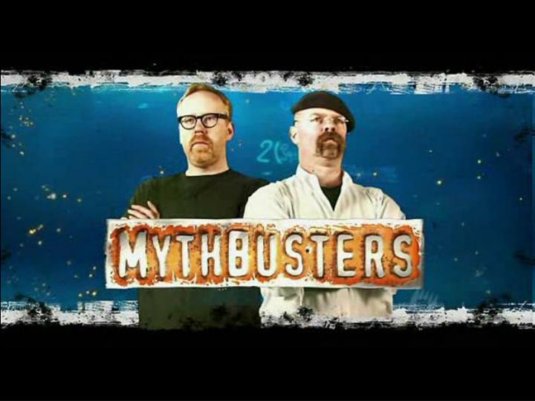
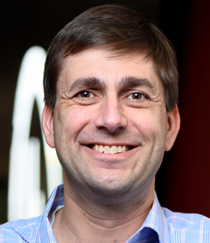
STANDARDS EDITION

Slide 11
Myth #1
UL writes the standards that they certify products to

Slide 12
Myth #1
UL writes the standards that they certify products to
BUSTED

Slide 13
TWO DISTINCT ORGANIZATIONS WITH ONE COMMON MISSION
Underwriters Laboratories Inc
(Nonprofit)
UL LLC
(Business Solution)
Standards
Research
Education
Outreach
Testing, Inspection & Certification
Software as a Service
Advisory Services
13

Slide 14
Myth #2
If a product doesn't have a consensus voluntary standard, it must be safe because standards only exist for unsafe products.

Slide 15
Myth #2
If a product doesn't have a consensus voluntary standard, it must be safe because standards only exist for unsafe products.
BUSTED

Slide 16
Myth #3
If a product meets the requirements of a consensus voluntary standard, it must be safe

Slide 17

Myth #3
If a product meets the requirements of a consensus voluntary standard, it must be safe

Slide 18
Compliance Safety
Compliance Function
Notes:
DM

Slide 19
Some problems with standards
The majority of products do not have mandatory or voluntary safety standards that are applicable to the product.
Where a standard applies, it may not apply to the entire product.
Many standards are performance standards that allow the manufacturer to design it any way they want. And the standard may allow a manufacturer to use one of several acceptable safety features.
Standards are sometimes not clear and are subject to interpretation.
There are overlapping standards and inconsistent standards from country to country.

Slide 20
Myth #4
CPSC regulations require compliance with all ASTM and UL standards.

Slide 21
Myth #4
CPSC regulations require compliance with all ASTM and UL standards.
BUSTED

Slide 22
Some problems with standards
Some standards are not really requirements, but merely guidance on how to do something.
Some standards have very specific requirements that are a bare minimum, and the manufacturer is prevented from exceeding the standard and still claim that they complied with the standard’s requirements.
And many standards are just made up without any technical or scientific analysis or testing on whether the requirements are likely to result in a safe product. They are merely educated guesses.
Compliance with foreign standards resulting in a safer product might be admissible to prove you can make a safer product than you do in the U.S.

Slide 23
Some problems with standards
Minutes of committee meetings are discoverable
Technology develops faster than standards are developed, or government regulations are enacted and implemented
Some consumer groups test product to their own standards which can differ from or exceed the voluntary consensus standards
A manufacturer can try a case and defend itself on standards compliance. The jury can hold the standard is a minimum and not adequate and that the manufacturer should have exceeded the standard, or the standard should have been stronger

Slide 24
For questions after the webinar, email SPSP at info@productsafetyprofessionals.org or contact speakers:
  Don@ProductSafetyInsights.com
  George.Borlase@ul.org
  kenrossesq@gmail.com
These slides, a link to this webinar and more standards material can be accessed at the SPSP website under “SPSP-webinar-series.”

Slide 25
Thank you for attending!
SPSP 2022 Webinar Series
March 16, 2022
Sponsored by Sedgwick Brand Protection
Notes:
Questions.
KR will ask questions and DM or JB can answer, depending on the question.

