Slide 1

SPSP 2023 Webinar Series
Warnings Update
October 11, 2023
1:00 – 2:00 p.m. EST
Sponsored by Sedgwick Brand Protection

Slide 2



SPSP Webinar Speakers
Gavin Huntley-Fenner
Huntley-Fenner Advisors
Steve Hall
Applied Safety and Ergonomics
Kenneth Ross
Bowman and Brooke LLP

Slide 3
Agenda
Introduction
Legal basis for warnings
ANSI Z535 update
Questions
Notes:
KR

Slide 4

Safety Hierarchy
“…when a safer design can reasonably be implemented and risks can reasonably be designed out of a product, adoption of the safer design is required over a warning that leaves a significant residuum of such risks.”

Slide 5
Warnings Must Be Provided If
The product is hazardous
The manufacturer knows or should know the product is hazardous
The hazard is not obvious to the user
The hazard will exist during reasonably foreseeable use or misuse

Slide 6
Obvious Hazards
Warning not required for obvious hazard
Because product user will or should already know of its existence. Diminishes impact of other warnings
Decided by trier of fact
Rationale: How to determine?
Related to reasonably foreseeable
Probability and severity also obvious

Slide 7
What is an adequate warning in the U.S.
It is in a form that could reasonably be expected to catch the attention of a reasonably prudent person in the circumstances of the product’s use;
The content is of such a nature as to be comprehensible to the average user; and
It conveys a fair indication of the nature and extent of the danger to the mind of a reasonably prudent person
Warning does not have to be followed in order for it to be adequate

Slide 8
Content of adequate warnings (law and standards)
Description of hazard
Probability of hazard occurring
Severity if occurs
How to avoid hazard

Slide 9

Voluntary Consensus Standards
Compliance is voluntary unless adopted by government.
Compliance may not protect manufacturer in product liability case. Can always do more.
Non-compliance used to argue that product could have and should have been made safer.

Slide 10
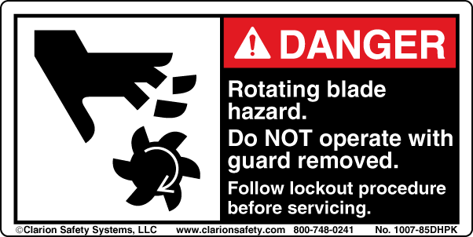
ANSI Z535.4
Signal word panel (required)
Safety alert symbol (required)
Signal word (required)
Symbol/pictorial
Word message panel
Label courtesy of Clarion Safety Systems
At least one is required

Slide 11
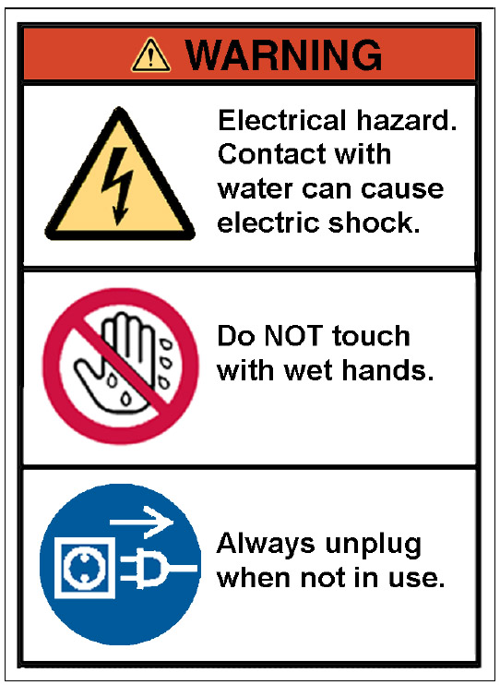
ISO 3864-2
General Warning Sign
Hazard Severity Panel
Supplementary Safety Information Text
At least one is required
Supplementary Safety Information Symbol
Safety Signs with Appropriate Surround Shapes and Colors

Slide 12





Current Harmonization
ISO and ANSI
(since 2006)
ANSI
For use with DANGER
For use with WARNING
For use with CAUTION
For use with all signal words

Slide 13
Proposal
Note: It is the intention of the ANSI Z535 committee to eliminate the non-ISO versions of the safety alert symbol in the next revision of this standard. Only options D and E as shown in Figure 1 will remain.

Slide 14

ISO 3864-2

Slide 15
Proposal

Slide 16
Proposal
6.1 Panels
A product safety sign or label typically consists of a signal word panel plus a message panel. On hazard alerting signs, in addition to a word message, a safety instruction panel may be incorporated as a place to convey lengthy instructional information (see Figure 13). A safety symbol panel may be used to communicate a part or all of the elements of a message panel (see Annex B3.1). If a safety symbol uses a surround shape with the appropriate safety color (e.g., hazard alerting yellow triangle, red circle/slash prohibition, mandatory action blue circle), the signal word panel may be omitted.

Slide 17
Proposal (Z535.3)
Option A: Create a new Annex D that is the most current version of ISO 7010 with the following introduction:
Shown below are the registered safety signs included in ISO 7010 as of the date of publication of this version of ANSI Z535.3.
Option B: create a new ANSI/ISO standard from ISO 7010

Slide 18
Current Harmonization
3.1.1 ISO-Formatted Safety Signs
Product safety information may be conveyed by ISO formatted safety labels in compliance with ISO 3864-2 (see Annex C).
Annex C
The Use of ISO Safety Signs for Products
(Informative)
ISO standards such as ISO 3864 and other industry-specific ISO standards exist for product safety signs and labels. These ISO-formatted safety signs have been used internationally for many years.
In some instances, it may be possible for a safety sign or label to be in conformance with ANSI Z535.4 and an ISO standard. In other instances, conformance with one standard will not result in conformance with one or more aspects of the other.
A decision to convey all or a portion of a product's safety information in the form of ISO-formatted signs may be based on many factors. Such factors include, but are not limited to the product's anticipated market, the movement of the product from country to country during its expected life, the target audience's characteristics, and space availability on the product.

Slide 19
Other topics
Symbols
Testing for comprehension
Multiple languages

Slide 20
Upcoming Webinars
November 8, 2023 – Instructions
December 6, 2023 – Improving Recall Effectiveness
Notes:
KR

Slide 21
For questions after the webinar, email SPSP at info@productsafetyprofessionals.org or contact speakers:
    gavin@huntleyfenneradvisors.com
    shall@appliedsafety.com
    kenrossesq@gmail.com
These slides, a link to a video of this webinar and more material can be accessed at https://www.productsafetyprofessionals.org/webinar-archive.

Slide 22
Questions?
Notes:
KR

Slide 23
Thank you for attending
SPSP 2023 Webinar Series
October 11, 2023
Sponsored by Sedgwick Brand Protection
Notes:
Questions.
KR will ask questions and DM or JB can answer, depending on the question.

