Slide 1
SPSP 2022 Webinar Series
How Product Liability Law and Practice Provide Guidance on Product Safety
November 16, 2022
1:00 – 2:00 p.m. ET
Sponsored by Sedgwick Brand Protection

Slide 2
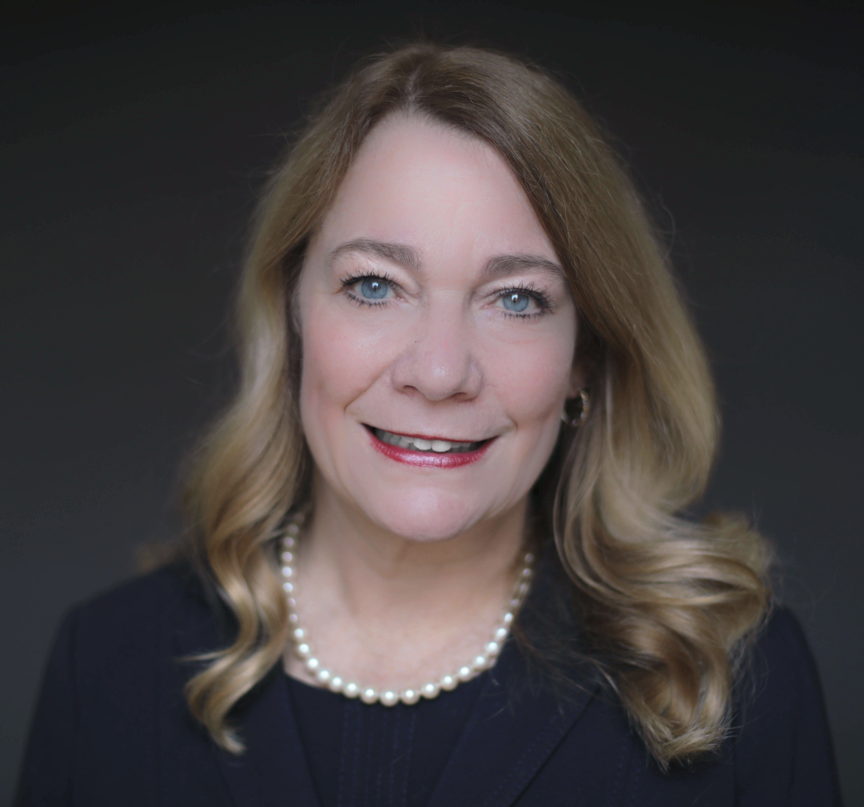
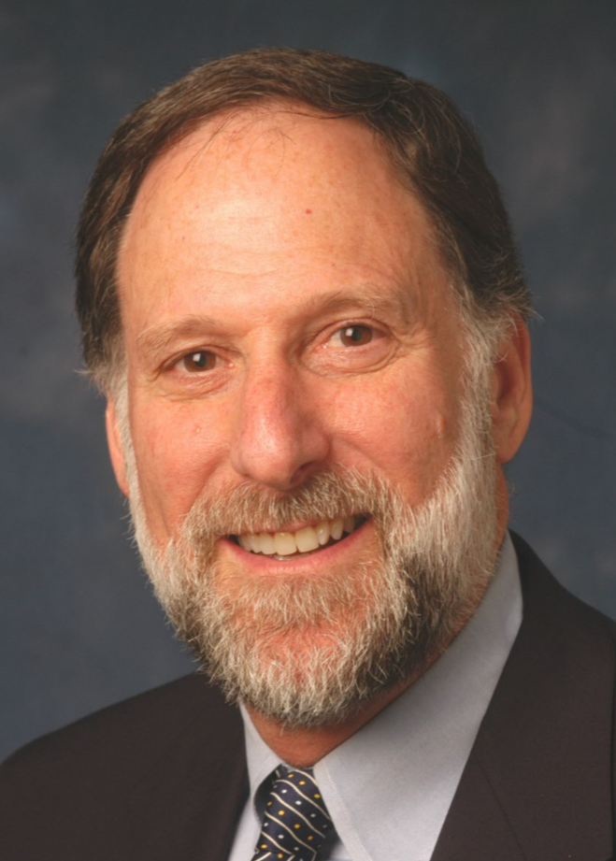
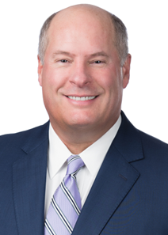
SPSP Webinar Speakers
Cheryl Possenti
Goldberg Segalla
Kenneth Ross
Bowman and Brooke LLP
John Kuppens
Nelson, Mullins
Notes:
KR will introduce the speakers and the subject

Slide 3
Goals of Safety Program
Goal is to prevent incidents or minimize risk
Before sale, do the following:
Adequate design and manufacturing processes
Adequate warnings and instructions
Comply with or exceed laws and regulations
Comply with or exceed mandatory and voluntary standards
After sale, understand and comply with post-sale duties
Adequately document the entire process
Doing above will help create a defense

Slide 4
What Plaintiffs Could Argue
Manufacturing defects
Design defects
Defects in warnings and instructions
Marketing defects
Post-sale negligence

Slide 5
Supplier selection/contracts
Litigation Management
Product Design
Accident Investigation
Manufacturing
PRODUCT
LIABILITY
Areas of Risk
Incident Reporting
On product warnings
Retrieval, Retrofit, Recall Procedures
Instructions/training
Post-market risk assessment
Marketing/Distribution
Post-market surveillance
Warranties

Slide 6
Effect of Litigation (Involving You and Others)
Accidents or incidents help identify risk
Identify what is foreseeable misuse
Battle of experts
Test your story
Help to make your product safer
Clarify law
Might affect duty to report to CPSC

Slide 7
Topics
Mandatory laws and regulations and voluntary standards
Product misuse
Warnings
Post-sale duties

Slide 8
Questions?

Slide 9
Next webinar January 2023
CPSC Update

Slide 10
For questions after the webinar, email SPSP at info@productsafetyprofessionals.org or contact speakers:
cpossenti@goldbergsegalla.com
john.kuppens@nelsonmullins.com
kenrossesq@gmail.com
These slides, a link to this webinar and more material on this subject can be accessed at the SPSP website under “SPSP-webinar-series.”

Slide 11
Thank you for attending!
SPSP 2022 Webinar Series
November 16, 2022
Sponsored by Sedgwick Brand Protection
Notes:
Questions.
KR will ask questions and DM or JB can answer, depending on the question.

