Slide 1
SPSP 2023 Webinar Series
Data Analytics and Product Safety
April 19, 2023
1:00 – 2:00 p.m. EST
Sponsored by Sedgwick Brand Protection

Slide 2
SPSP Webinar Speakers
Don Mays
Product Safety Insights VP, SPSP
Alan Abrahams
Virginia Tech
Derek Snaidauf
Deloitte

Slide 3
Agenda
Handling the challenge of TMI
What is advanced data analytics?
Smoke terms
Analytical methods
Data visualization
Examples of early warning successes
Notes:
KR

Slide 4
Post-Sale Product Data Sources
Internal
Call Center records
Emails
Letters
Retailer notifications
Warranty claims
Service network notifications
Parts replenishment
Product forums
Legal claims
External
Retailer customer reviews
Media inquiries
Mass media reports
Enthusiast blogs and forums
Social media postings
CPSC SaferProducts.gov
CPSC databases
Better Business Bureau

Slide 5
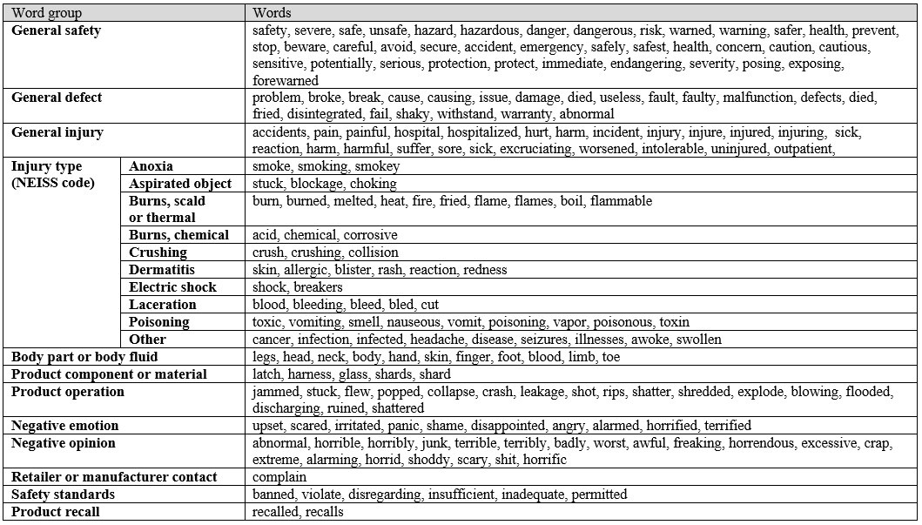
The common words consumers really use to express safety concerns…
Smoke Term Dictionaries
Source: 185,000+ product reviews across 26 industries
collaboratively tagged by 1,300+ Virginia Tech students

Slide 6
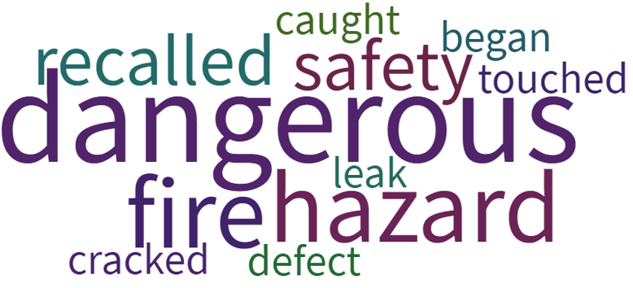
Smoke words are highly industry-specific. In countertop appliances, there are 11 key smoke terms, some unexpected!
Smoke Term Dictionaries
Countertop Appliances: Smoke Terms
Source: 80,000+ countertop appliance reviews from 3 major American online retailers

Slide 7
Smoke Term Dictionaries
Children’s Toys: Smoke Terms
Hospital Admissions
Recalls
Overlap
Word | Score
fell | 19.16
hit | 9.27
swallowed | 8.99
tripped | 8.17
fracture | 7.39
femur | 6.98
fractured | 6.37
pain | 6.02
skull | 5.72
admitted | 5.62
ingested | 5.52
injury | 5.23
hitting | 4.67
landed | 4.31
admit | 4.31
ingestion | 4.06
fall | 4.06
laceration | 3.92
humerus | 3.66
stuck | 3.50
Word | Score
choking | 32.78
recalled | 18.75
recalls | 16.82
lead | 16.78
hazard | 14.73
recall | 12.83
laceration | 10.50
burn | 8.72
paint | 8.34
violation | 8.14
fire | 8.08
hazards | 7.53
strangulation | 6.95
ingestion | 6.48
wooden | 6.23
aspiration | 6.15
posing | 5.71
injury | 5.03
injuries | 4.93
internal | 4.83
Word
swallowed
ingested
injury
ingestion
fall
laceration
choking
aspiration
vomiting
fire
pieces
removed

Slide 8
Smoke Term Dictionaries
Assistive Products for Older Adults: Smoke Terms
dangerous
unsafe
slippery
sharp
wobbly
cutouts
shaky
loose
hurts
killed
unevenly
splay
fall
cautious
moves
risk
injured
detached
slippage
kill
bloating
unbalanced
bruise
shocks

Slide 9
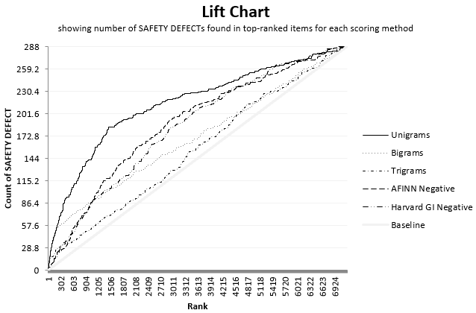
Smoke Terms vs Sentiment Analysis
Finding hazards faster
using ranked computer-scored reviews
Notes:
Elderly product reviews, scored using Pamplin Text Analytics Toolbox (PamTAT)

Slide 10
Smoke Terms vs Sentiment Analysis
Top 400 Scoring Posts for Each Method (Toy Industry)
Smoke
SentiStrength
Star Rating
156
244
21
379
6
394
Safety Concerns
No Concern
Smoke lists are most effective.
With sentiment analysis, safety concerns are masked behind other irate posts.
Notes:
In the top 400 posts for each scoring method, we looked for safety concerns. 7x more safety concerns were found in the (Recall) smoke scoring method, than in sentiment scoring. This is because sentiment scoring finds many irate posts unrelated to safety, such as issues with color, size, price/value, durability, packaging, etc.

Slide 11
Virginia Tech’s Software

Slide 12
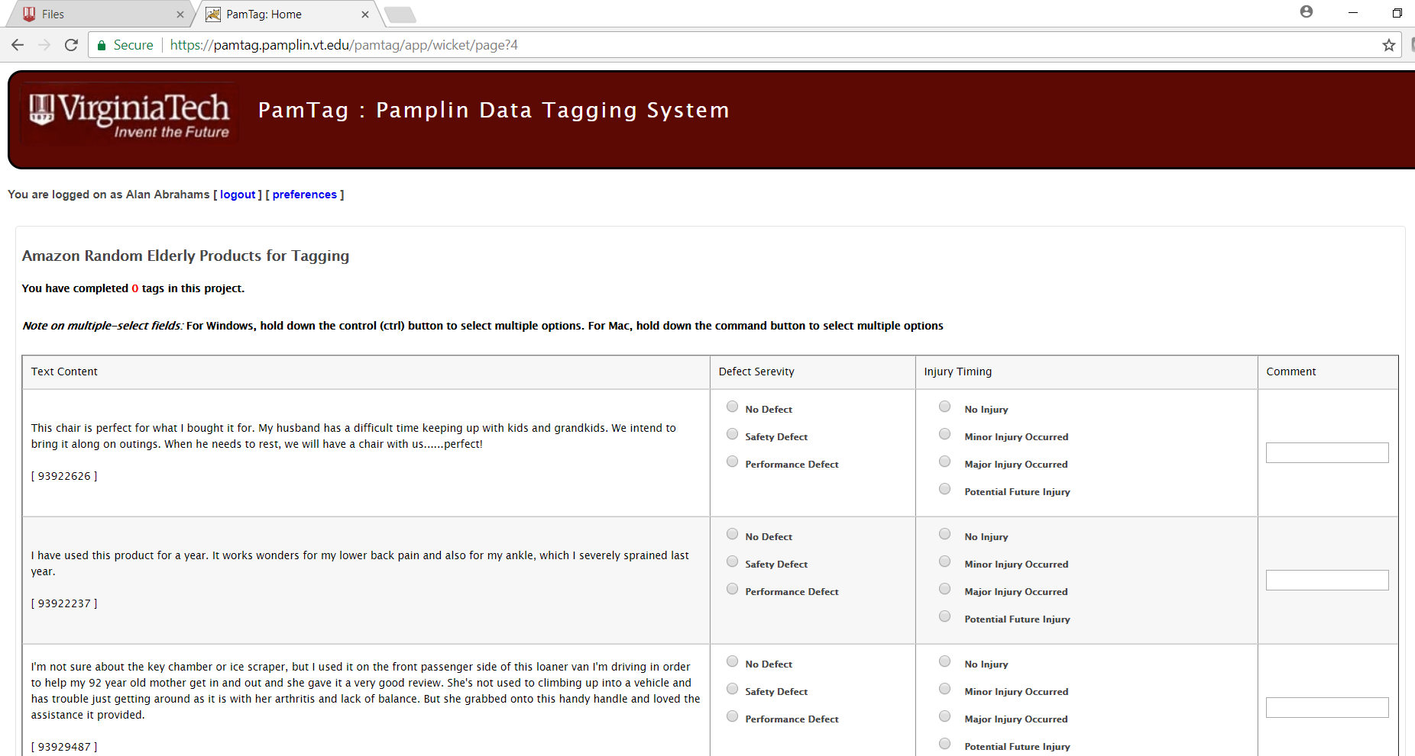
Training AI: Collaborative Tagging
At no cost, assemble human teams to label safety concerns buried in millions of product reviews
80+ million reviews
500,000+ labelled by
4,000+ humans, 30+ product categories
Notes:
https://pamtag.pamplin.vt.edu/
To train good AI, you need good quality human-labelled data, in large volumes.
PamTag, at peak utilization has allowed 10,000 online product reviews to be labelled by humans per day.
Our home-grown web-based collaborative tagging tool, PamTag, supports large-scale human labelling of online reviews.
Other Crowdsourced Human Data Labeling services: Amazon Mechanical Turk, Amazon SageMaker GroundTruth, Prolific, Figure Eight, TheHive.ai, Appen, LionBridge Data Annotation ( https://lionbridge.ai/data-annotation-platform/ ), Skyl.ai Labelwise Data Labeling Platform, Suntec.ai Text Annotation Services, CogitoTech Text Annotation, … Reliability of these tools is typically the biggest concern, since the human annotators are often low-skilled, or low-paid. Some tools allow you to filter / qualify members of your labeling team and/or assess rater-reliability in real time. For our academic research we typically use our home-grown Virginia Tech PamTag platform, which incorporates inter-rater reliability checks to compare human rater reliability.
Online reviews can be sourced using various systems:
social media monitoring: to collect social media mentions for the corporate trademarks (e.g. Meltwater, Brandwatch, Rankur, Sprout Social, Nuvi, HootSuite Monitor, AgoraPulse, Netbase Quid, SocialBakers Listening and Intelligence, Critical Mention, Clarabridge, TweetDeck, TalkWalker, Mention.com, …). See https://buffer.com/library/social-media-monitoring-tools/
Note that a limitation of the social media monitoring tools is that they collect thousands or millions of mentions, and can typically only classify them as positive or negative, so they go a few very big steps short of identifying safety concerns – to be helpful for identifying safety concerns, text labelling and text classification services must be (typically separately) procured, to weed out the safety concerns from thousands or millions of negative mentions (e.g. about non-safety-issues like color, durability, price, etc.)
news monitoring (e.g. Aylien corporate risk monitoring from online news)
online product-review monitoring (e.g. BazaarVoice, IntelligentEye, ReviewMonitoring.com, ...). This is more specialized than the social media monitoring tools above, since the social media monitoring tools often cannot link comments to particular model numbers, whereas the online-retailer product-review monitoring tools can link user comments to particular model numbers.
search term monitoring (e.g. Google Adwords). Monitor what phrases consumers are searching for – e.g. “Samsung oven recall” – is helpful since consumers often search if other consumers have a safety concern, before making the effort of writing their own report, so can provide a very early indicator of a potential product safety concern.
With our academic partners, we use home-grown web-scrapers, able to scrape online reviews, discussion forums, etc. (usually built in Selenium or python). We also maintain an internal dataset of thousands of safety hazard reports across dozens of product categories, which allows us to generate product-category-specific smoke terms (words and phrases often used in hazard reports in those product categories) for particular product categories of interest.

Slide 13
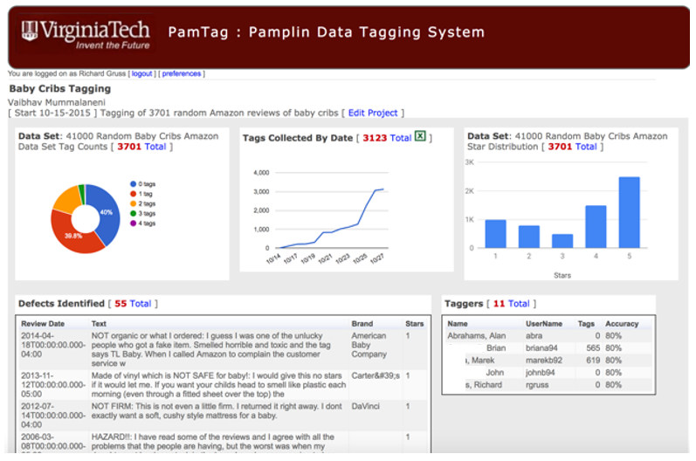
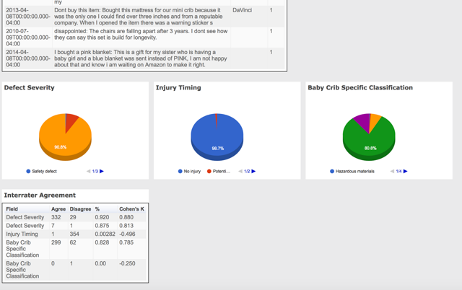
Training AI: Collaborative Tagging
Track the activity and inter-rater reliability
(regular vs authority coders)
of your human safety concern labeling teams
Notes:
https://pamtag.pamplin.vt.edu/
This slide shows the PamTag management dashboard: Track the activity and reliability of your human labelling team, and the safety concerns discovered, and the characteristics of these safety concerns, in real time. Coder (human labeler) reliability is retrospectively reviewed also, and “rogue taggers” are disqualified, if they are unreliable, such as disagreeing frequently with our Authority labelers, or forgetting to capture snippets of safety concerns frequently.

Slide 14
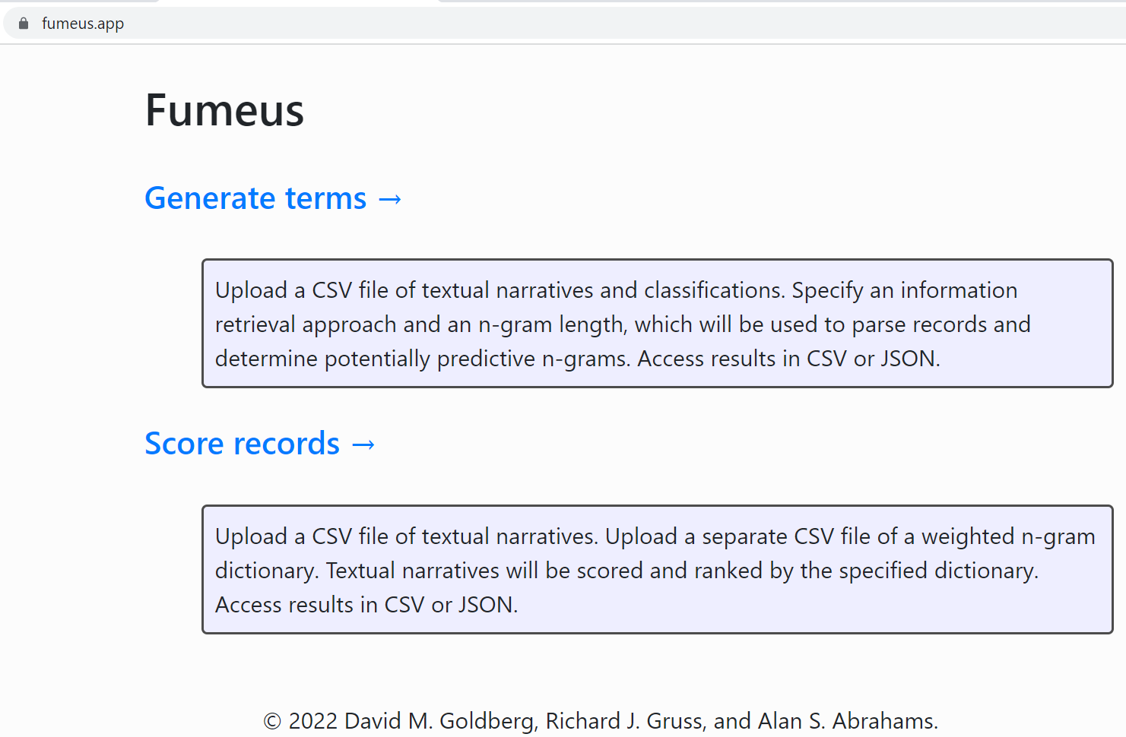
Generating and Using Smoke Terms
Generate, test, and deploy
your own custom smoke term dictionaries
fumeus.app
(Free, web-browser based, no log-in needed; open-source)
Notes:
Our research has shown that smoke term dictionary performance is heavily product-category specific. Smoke terms work best when the smoke term dictionary is tailored to the product-category of interest. Our smoke term discovery & scoring software is freely available to the international research, business, & government community.
Citation: Goldberg DM, Gruss R, Zaman N, and Abrahams AS. Fumeus: A family of Python tools for text mining with smoke terms. Software Impacts, Volume 12 (May), 1-4.
Fumeus is a home-grown tool we use for discovering smoke-terms, and scoring using smoke terms. We have made this available free and open-source, via the web, or downloadable software.
Our free (also made available open-source) MARS tool (available online via web, or downloadable) provides default state-of-the-art classifiers (including deep learning, like CNN, and Support Vector Machine, Random Forest, Decision Tree, Naïve Bayes, and Logistic Regression classifiers): see https://mars-classifier-evaluation.herokuapp.com/ and:
Mali N, Restrepo F, Abrahams AS, and Ractham P. (2022). Implementation of MARS metrics and MARS charts for evaluating classifier exclusivity: the comparative uniqueness of binary classifier predictions. Software Impacts, Volume 12 (May), 1-6.
Other, commercial AI products for training safety-concern-discovery AI: Amazon SageMaker, Tensorflow, Google AutoML (Google AI Platform: https://cloud.google.com/ai-platform ), MonkeyLearn (e.g. see https://monkeylearn.com/blog/ticket-classification-with-ai/ ), BigSquid.ai, MeaningCloud, Rosette ( https://www.rosette.com/capability/categorizer/ ), Skyl.ai, Suntec.ai, CogitoTech Text Classification, …
For our academic research, we typically use home-grown tools (fumeus.app for the web, and our equivalent PamTAT desktop toolbox for Excel). These tools find “smoke terms” (words and phrases unusually prevalent in safety concerns), and allow new text snippets to be scored using product-category-specific smoke terms (high scores indicate higher likelihood that a safety concern was mentioned).

Slide 15
Safety Data Analytics Infrastructure
April 2023

Slide 16
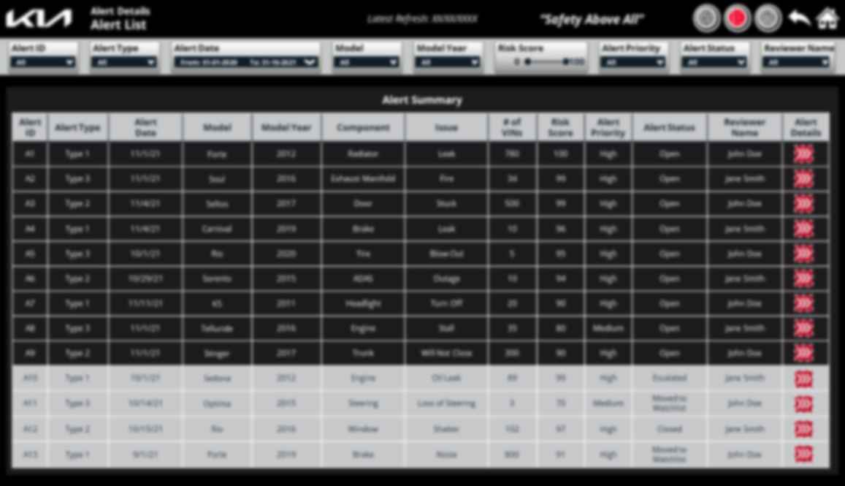
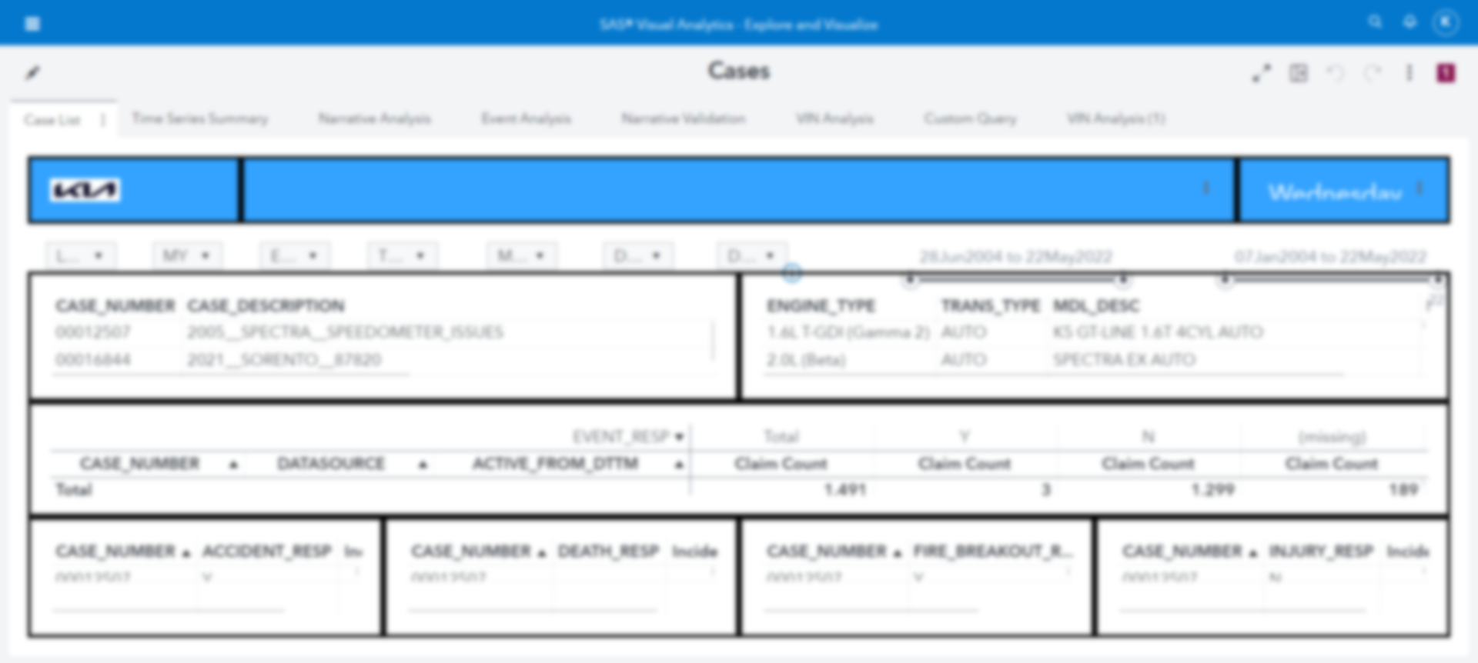
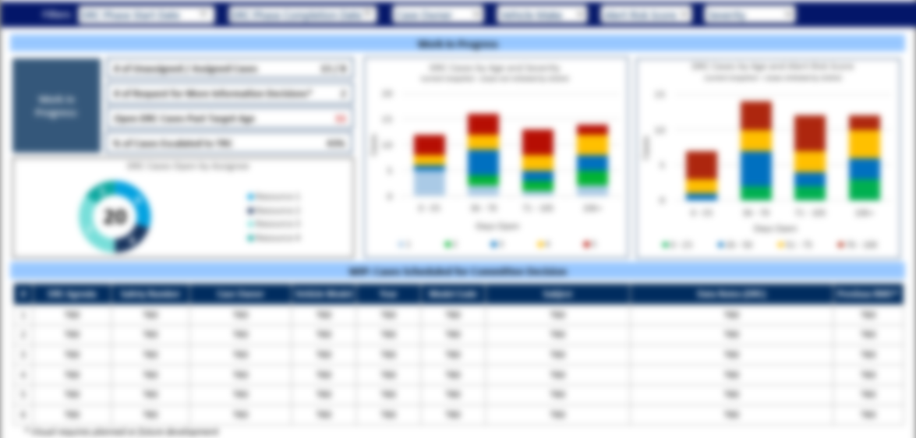
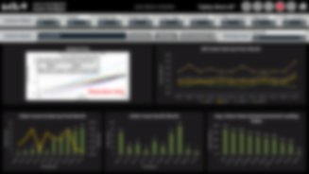
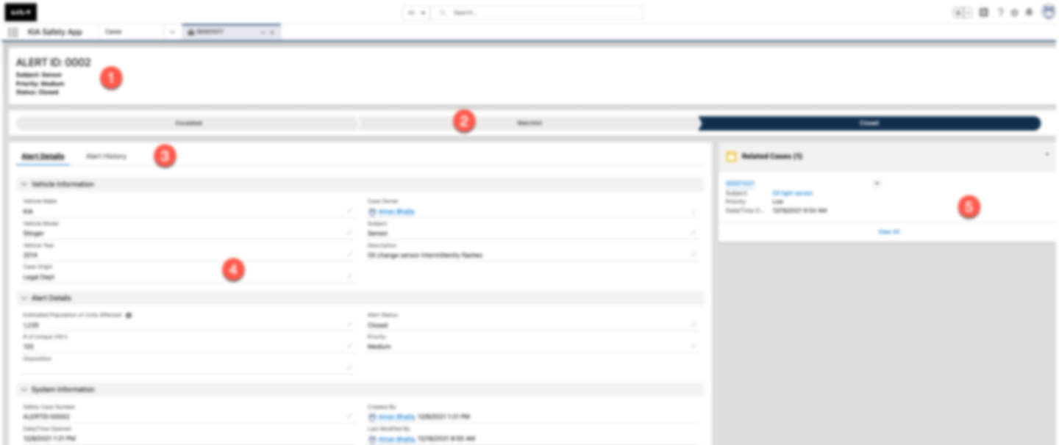
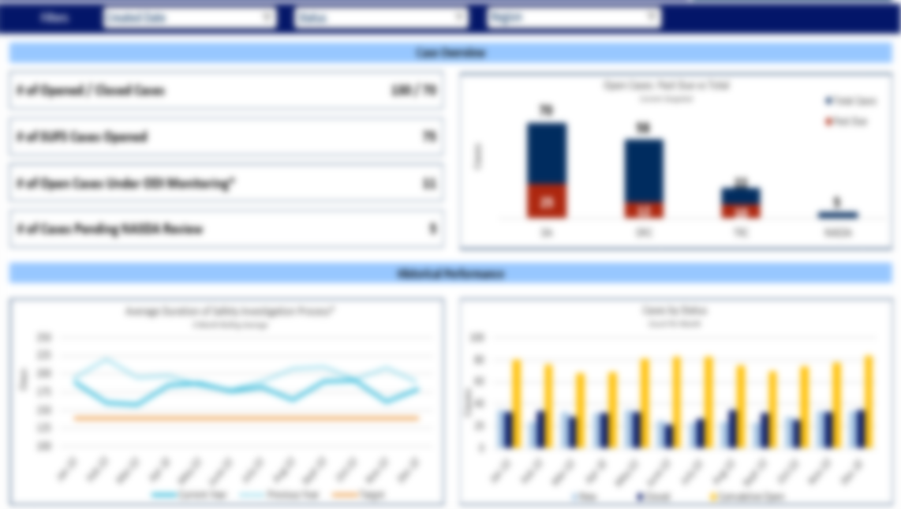
Components of a Leading-Class Safety Data Analytics Infrastructure (SDAI)
A truly leading-class system supports the end-to-end safety issue lifecycle with a centralized safety data repository and an integrated set of advanced analytics, workflow, and process monitoring tools
Safety Issue Lifecycle
Event
Occurs
Case
Investigated
Regulatory
Reporting
Remedy Efficiency
Alert Disposition
Recall Decision
Case
Opened
Alert
Created
Alert Escalated
Other
Reporting
Launch Recall
Data Staging & Analytics
Reporting & Workflow
1
Safety Data Staging
Text Categorization
Internal Hotline
Machine Learning Models
2
Alert Prioritization & Issue Investigation
3
Case Management & Workflow Automation
4
End-to-End Process Monitoring
Technician Data
Rule-Based Models
Warranty Claims
Issue Alerting Engine
Cust Call Center
Anomaly Detection
Customer Relations
IoT/Sensor
Trend Analysis
Regulatory
Remedy Efficiency
Product Quality
Escalations from Support Teams
Field Quality
Automated Reliability Monitoring
Social Sentiment
Central Data Repository
5
Process Assessment and Training
Proprietary and Confidential

Slide 17
A Leading-Class SDAI Identifies Product Safety Issues Earlier than Traditional Methods
The Issue
With increasing pressure to identify quality, warranty, and safety issues quickly and limit the scope of service campaigns and recalls,
manufacturers must find innovative ways to distill the vast and disparate data generated in the field
Leading Practice: Proactive Sensing
Proactive Sensing cross-correlates all available structured and unstructured defect data sources…
…using pre-defined and tested algorithms and risk dictionaries…
..in order to prompt investigators with automatic alerts.
Supplier Data
Warranty Data
Customer Complaints
Repair Orders
MFG Process Data
IoT/Sensor Data
Regulatory Complaints
Social Sentiment
Advanced Algorithms
Line-Item Risk Dictionary
Automatic, Prioritized Defect Alerts
The Business Value: Proactive Sensing vs. Traditional Issue Detection*
# of Defective Products Produced
ILLUSTRATIVE
6M
Campaign Launched
3M Fewer Products Repaired
5M
4M
Campaign Launched
3M
2M
1M
Investigation
Investigation
Q1’21
Q2’21
Q3’21
Q4’21
Q1’22
Q2’22
Q3’22
Q4’22
Issue identified by Proactive Sensing
Issue Identified More Than 1 Year Early
Issue identified by traditional methods
Proprietary and Confidential

Slide 18
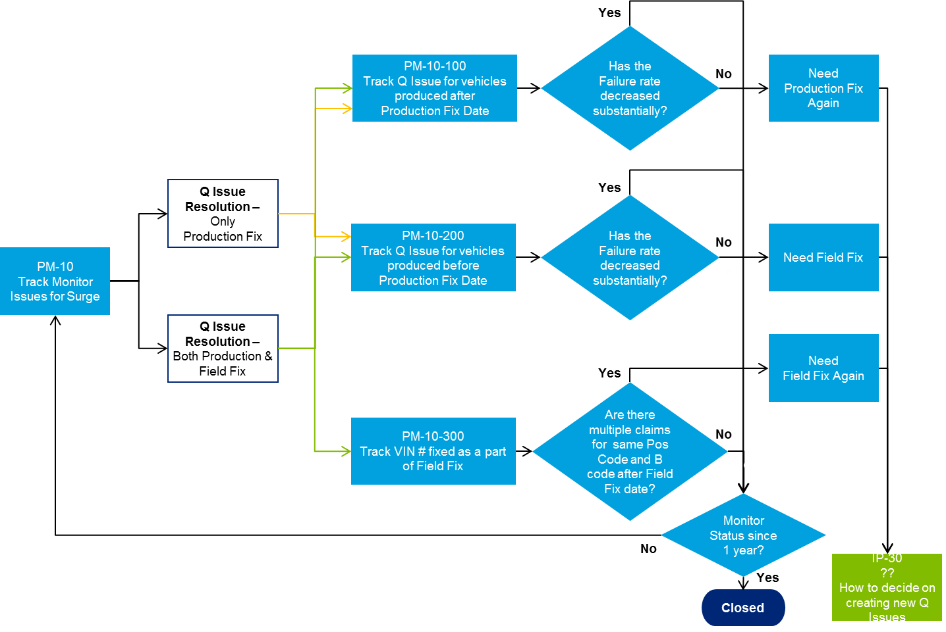
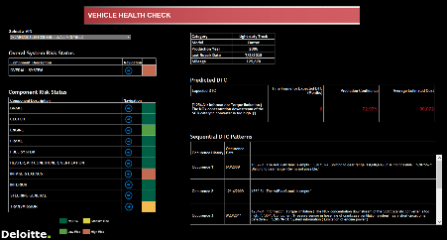
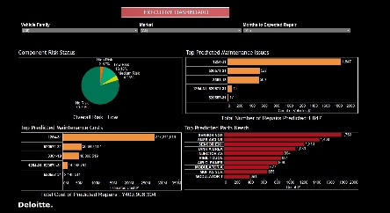
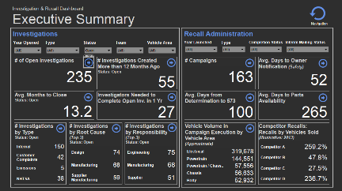
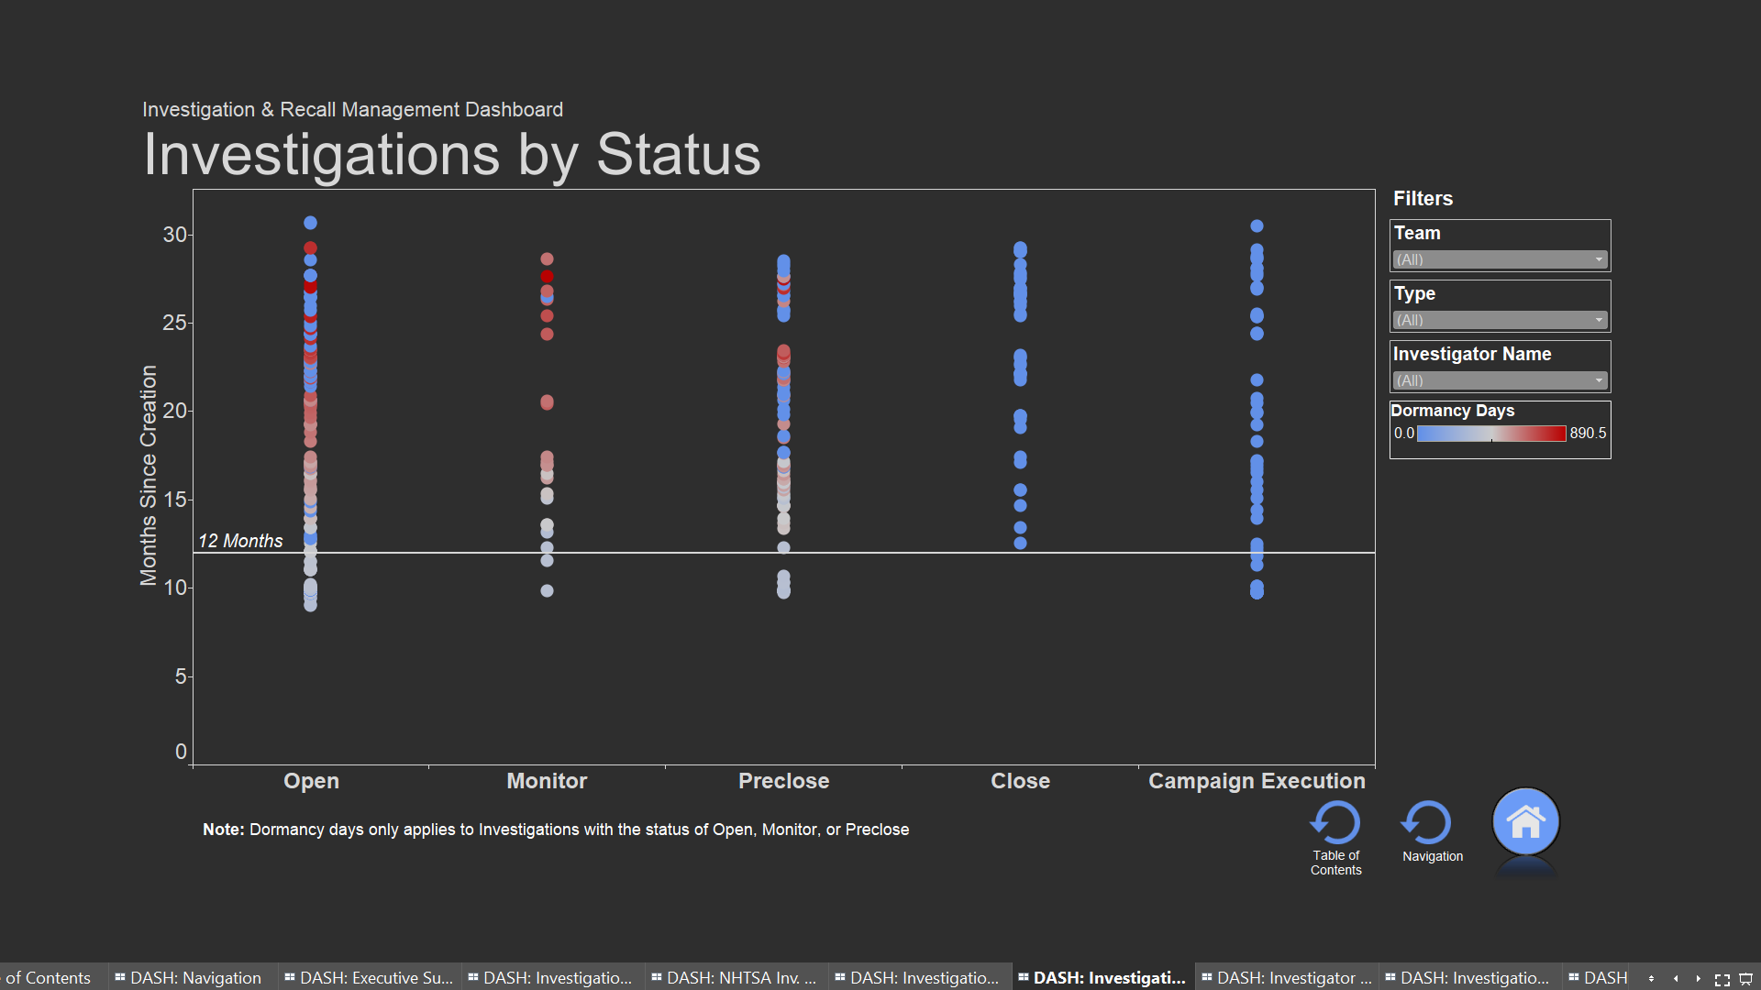
Data visualizations enable end-to-end issue management, performance monitoring, and research and analysis
Proactive Sensing
Proactive Monitoring
Proactively identify emerging safety issues using warranty claims, customer narratives, and other sources
Proactively monitor the effectiveness of field and production fixes
Proactive Diagnosis
Campaign Management
Predict failures using diagnostic trouble codes and streaming sensor data
Enable more effective tracking and management of the investigation and campaign process
Key Features
Large scale integration and correlation of data sources
!
Prioritized scores/alerts for effective resource utilization
Robust executive and end-user visualization capabilities
Quicker, more proactive detection of potential safety issues
Effective management and monitoring of campaigns
Integrated with existing business and management processes

Slide 19
Q & A

Slide 20
For questions after the webinar, email SPSP at info@productsafetyprofessionals.org or contact speakers:
Don@ProductSafetyInsights.com
Abra@vt.edu
DSnaidauf@Deloitte.com
These slides, a link to a video of this webinar and more material can be accessed at https://www.productsafetyprofessionals.org/webinar-archive.

Slide 21
Upcoming Webinars
April 26, 2023 – Ethics and Product Safety – a joint ICPHSO & SPSP webinar
May 17, 2023 – Insurance Company Guidance on Product Safety
June 20, 2023 – International Update
Notes:
KR

Slide 22
SPSP/ADK Educational Programs
Product Safety Certification Program - at Virginia Tech – ongoing
Fundamentals of Product Safety Management - at University of Michigan - 6/20 – 8/11
Product Safety Leadership – Crisis Management – at University of Missouri St. Louis – 11/6 -11/10

Slide 23
Thank you for attending!
SPSP 2023 Webinar Series
April 19, 2023
Sponsored by Sedgwick Brand Protection
Notes:
Questions.
KR will ask questions and DM or JB can answer, depending on the question.

