Slide 1
SPSP 2021 Webinar Series
Product Safety Management Best Practices:
Recall Preparation
September 15, 2021
Sponsored by Sedgwick Brand Protection

Slide 2
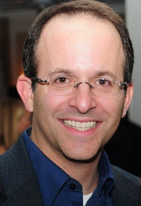
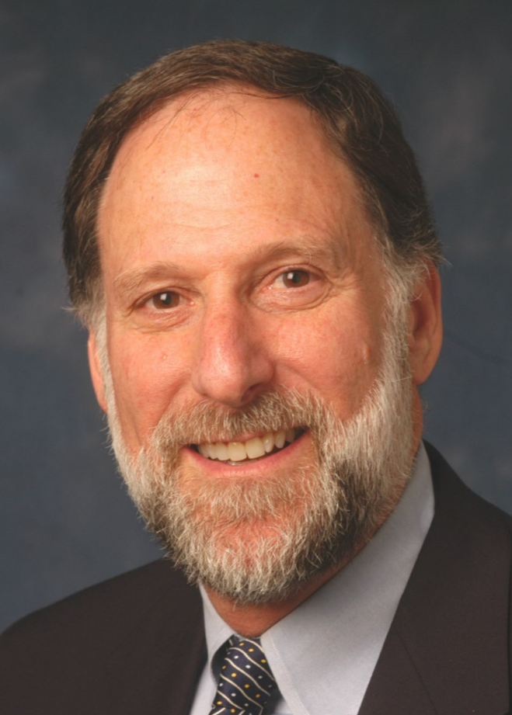
SPSP Webinar Speakers
Jason Hertzberg
Corporate Vice President and Principal Engineer
Exponent, Inc.
Kenneth Ross
Of Counsel
Bowman and Brooke LLP
Chris Harvey
Sr. Vice-President Client Services Sedgwick
Notes:
KR will introduce the speakers and the subject

Slide 3
Pre-sale Recall Preparation
Supplier or OEM should establish product traceability procedures on product, on safety critical parts, and in sales documentation to more easily find affected population.
Notes:
KR

Slide 4
Pre-sale Recall Preparation
Establish extra rigorous QC procedures for safety critical parts.
Notes:
KR

Slide 6
Safety Valve Function
6
Spring loaded operation
When pilot flame established, magnet is energized + valve open (magnet beats the spring)
When pilot flame is lost, magnet is de-energized + valve closes (spring beats the magnet)
Notes:
The way the gas valve worked was based on the action of a spring and energized magnet.
When the pilot flame was established for the valve (what is referred to as ‘proof of pilot’), the magnet was energized and pulled down to allow for gas flow as you can see in the schematic at the top, where the gas flow from left to right is represented in BLUE.
When the pilot flame was lost, the magnet was deenergized and the spring uncoiled, pushing the magnet up and closing off the pathway for gas flow, as you can see in the schematic on the bottom, where the BLUE gas is not making it past the valve.

Slide 7
Pre-sale Recall Preparation
Develop recall plan including where post-sale safety information goes within the organization, and what they are supposed to do to analyze it and make a decision on what to do. Plan should also include a description of how to implement a recall and who is responsible for what. And plan could include how to test the adequacy of the plan through trial runs or mock recalls.
Notes:
KR

Slide 8
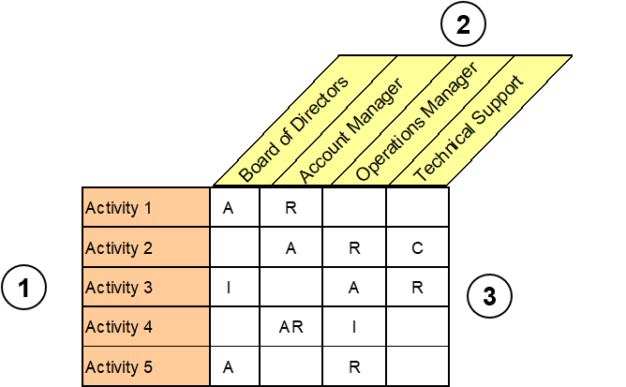
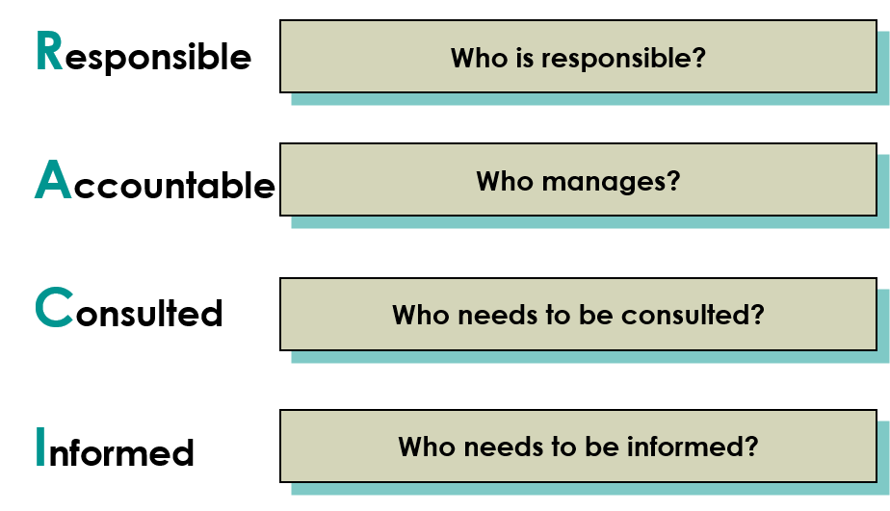
Methodology: RACI Chart Introduction
The RACI chart is a well established tool used to document roles and responsibilities for business activities or processes

Slide 9
Pre-sale Recall Preparation
Train client’s customer service personnel and what information they need to obtain to identify potential safety issue
Notes:
KR

Slide 10
Pre-sale Recall Preparation
Train all relevant personnel within company on their responsibilities and how to minimize the chance of creating unnecessarily harmful information as they do their jobs. Ask suppliers and sellers to likewise train their people to be careful when discussing post-sale safety issues and incidents.
Notes:
KR

Slide 11
Next webinar
Risk assessment – October 13
Webinars in November and maybe December. Topics to be selected.
There will be a Recall Preparation webinar, Part 2, in the future. Subjects include recall insurance and how to protect yourself from recall exposure.

Slide 12
Questions?
For questions after the webinar, email SPSP at info@productsafetyprofessionals.org, or contact speakers:
jhertzberg@exponent.com
kenrossesq@gmail.com
chris.harvey@sedgwick.com
These slides, a link to this webinar and more recall preparation material can be accessed at the SPSP website under “spsp-webinar-series”

Slide 13
Thank you for attending!
SPSP 2021 Webinar Series
September 15, 2021
Sponsored by Sedgwick Brand Protection
Notes:
Questions.
KR will ask questions and DM or JB can answer, depending on the question.

