Slide 1
SPSP 2023 Webinar Series
Insurance Company Guidance on Product Safety
May 17, 2023
1:00 – 2:00 p.m. EST
Sponsored by Sedgwick Brand Protection

Slide 2
SPSP Webinar Speakers
Phil Kass
CNA
Karine Narr
Chubb
Kenneth Ross
Bowman and Brooke LLP

Slide 3
Disclaimers
Chubb Disclaimer
The material presented herein is not intended to provide legal or other expert advice as to any of the subjects mentioned, but rather is presented for general information only. You should consult knowledgeable legal counsel or other knowledgeable experts as to any legal or technical questions you may have. The opinions and positions expressed in this presentation are the presenter’s own and not necessarily those of Chubb.
CNA Notice and Disclaimer
The information, examples and suggestions presented in this material have been developed from sources believed to be reliable, but they should not be construed as legal or other professional advice. CNA accepts no responsibility for the accuracy or completeness of this material and recommends the consultation with competent legal counsel and/or other professional advisors before applying this material in any particular factual situations. This material is for illustrative purposes and is not intended to constitute a contract. Please remember that only the relevant insurance policy can provide the actual terms, coverages, amounts, conditions and exclusions for an insured. All products and services may not be available in all states and may be subject to change without notice. “CNA” is a registered trademark of CNA Financial Corporation. Certain CNA Financial Corporation subsidiaries use the “CNA” trademark in connection with insurance underwriting and claims activities.

Slide 4
Agenda
Commercial General Liability
Product Liability – Theories of Recovery
Prevent, Respond, Defend, Transfer
Questions
Notes:
KR

Slide 5
Commercial General Liability Policy
A standard commercial general liability (CGL) insurance policy issued to businesses to protect them against liability claims for bodily injury (BI) and property damage (PD) arising out of premises operations, products, and completed operations; and advertising and personal injury (PI) liability.
Product Liability Coverage responds in the event of:
Third Party Bodily Injury
Third Party Property Damage
What is not covered by the CGL?
Recall Expenses
Errors and Omissions
Financial Injury
Inadequate Work
Negligent Actions
Discontinued Products
PL
E&O
Notes:
PHIL KASS to Start
Self Created Image
Characteristics of a GL claim:
Low frequency (except for food products)
Higher severity
High defense costs
Time commitment required from insured to defend claims
Defense requires good documentation
Recall costs are not covered
Most vulnerable asset not covered by insurance is your brand reputation
Claims generally take a long time to settle

Slide 6
Product Liability – Theories of Recovery
Breach of Warranty – implied or expressed
Negligence - The manufacturer is obliged to exercise “reasonable” care in the design and manufacture of their product so injury does not occur to a user of the product or others.
Strict Liability /Tort Law– “Defective”
Three Elements of Evidence
Product was defective
Defect existed at the time the product left the manufacturer
The defect caused or contributed to the bodily injury or property damage
Notes:
KARINE

Slide 7
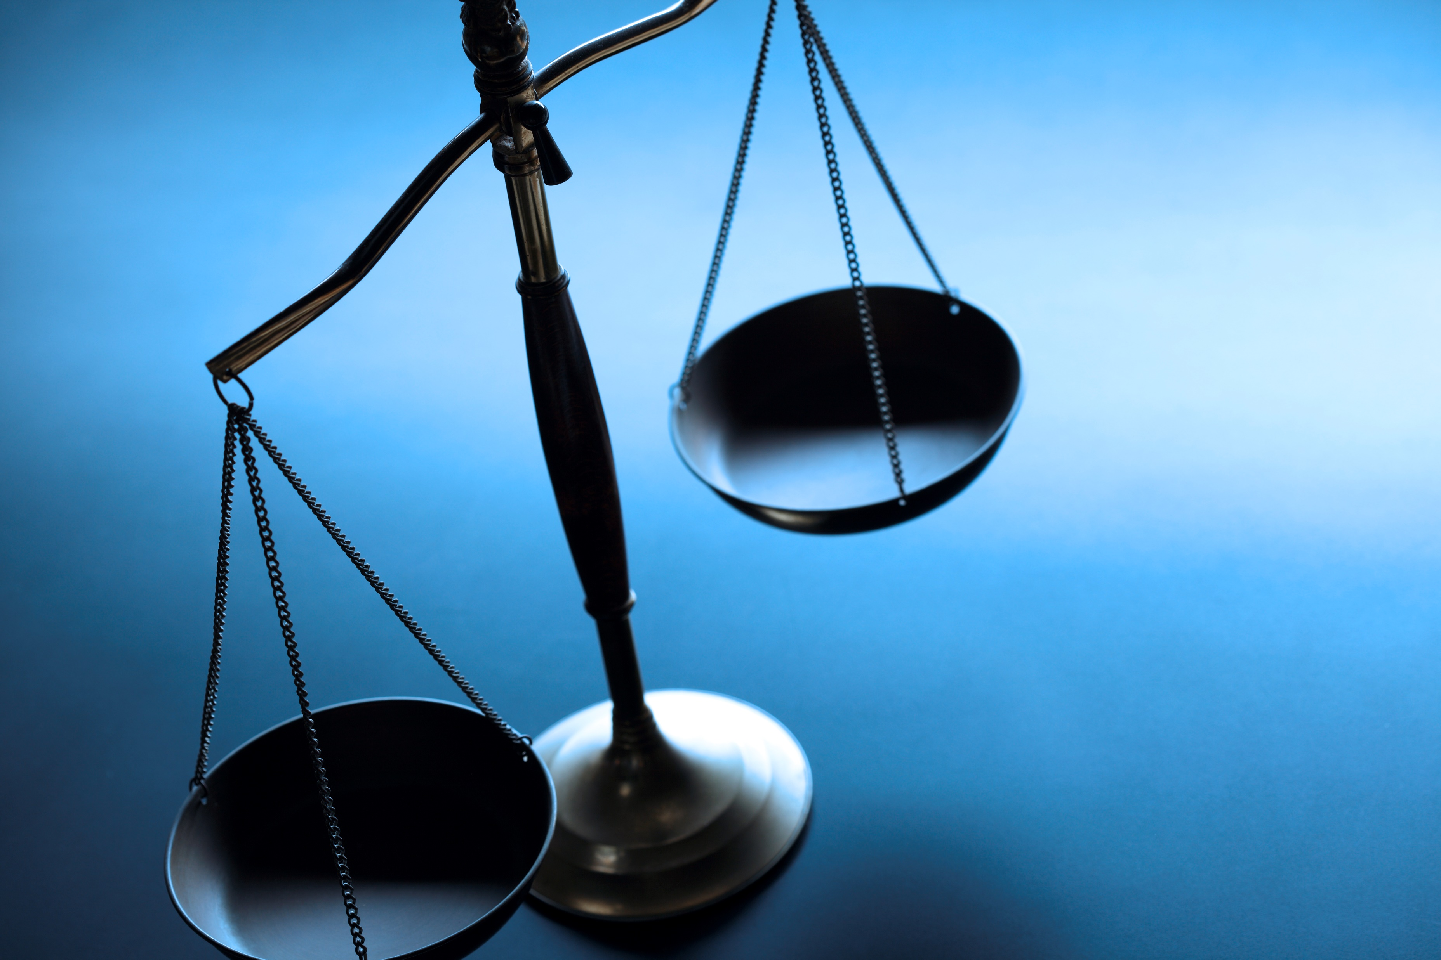
Product Safety vs. Product Liability
Prevent
Respond
Defend
Risk Transfer
Notes:
Stock Image
Product safety and product liability are not the same thing. You can design and build a safe product and still have a liability claim/lawsuit. Product had the safety level the designer intended, but someone still got hurt or it caused property damage. Plaintiff argues an alternative safer design should have been used. From an insurance perspective I am assessing the company’s ability to Prevent, Respond, Defend, and Transfer risk.

Slide 8
Product Safety vs. Product Liability
Prevent
Respond
Defend
Transfer
Design Practices
Manufacturing
Quality Control
Manuals and Warning Labels
Notes:
Stock Image

Slide 9
Product Safety vs. Product Liability
Prevent
Respond
Defend
Transfer
Warranty
Market Surveillance
Customer Complaint Handling
Recall Procedures
Notes:
Stock Image

Slide 10
Product Safety vs. Product Liability
Prevent
Respond
Defend
Transfer
Documentation
Design Decisions
Quality Control
Installation
Training
Customer Complaints
Notes:
Stock Image

Slide 11
Product Safety vs. Product Liability
Prevent
Respond
Defend
Transfer
Subcontractors
Suppliers
Customers
Certificates of Insurance
Notes:
A products liability survey should evaluate the potential for a defect in design, manufacturing, labeling, or advertising to cause bodily injury or property damage. It should assess adequacy of control systems intended to prevent such defects. Analyze mitigating factors that limit the probability for adverse outcomes. Identify measures intended to respond to adverse events, transfer liability and/or defend claims as appropriate.’

Slide 12
Questions?
Notes:
KR

Slide 13
Upcoming Webinars
June 20, 2023 – International Update
Notes:
KR

Slide 14
Thank you for attending!
SPSP 2023 Webinar Series
May 17, 2023
Sponsored by Sedgwick Brand Protection
Notes:
Questions.
KR will ask questions and DM or JB can answer, depending on the question.

