Slide 1
SPSP 2023 Webinar Series
Post-sale Incident Analysis
March 16, 2023
1:00 – 2:00 p.m. EST
Sponsored by Sedgwick Brand Protection

Slide 2
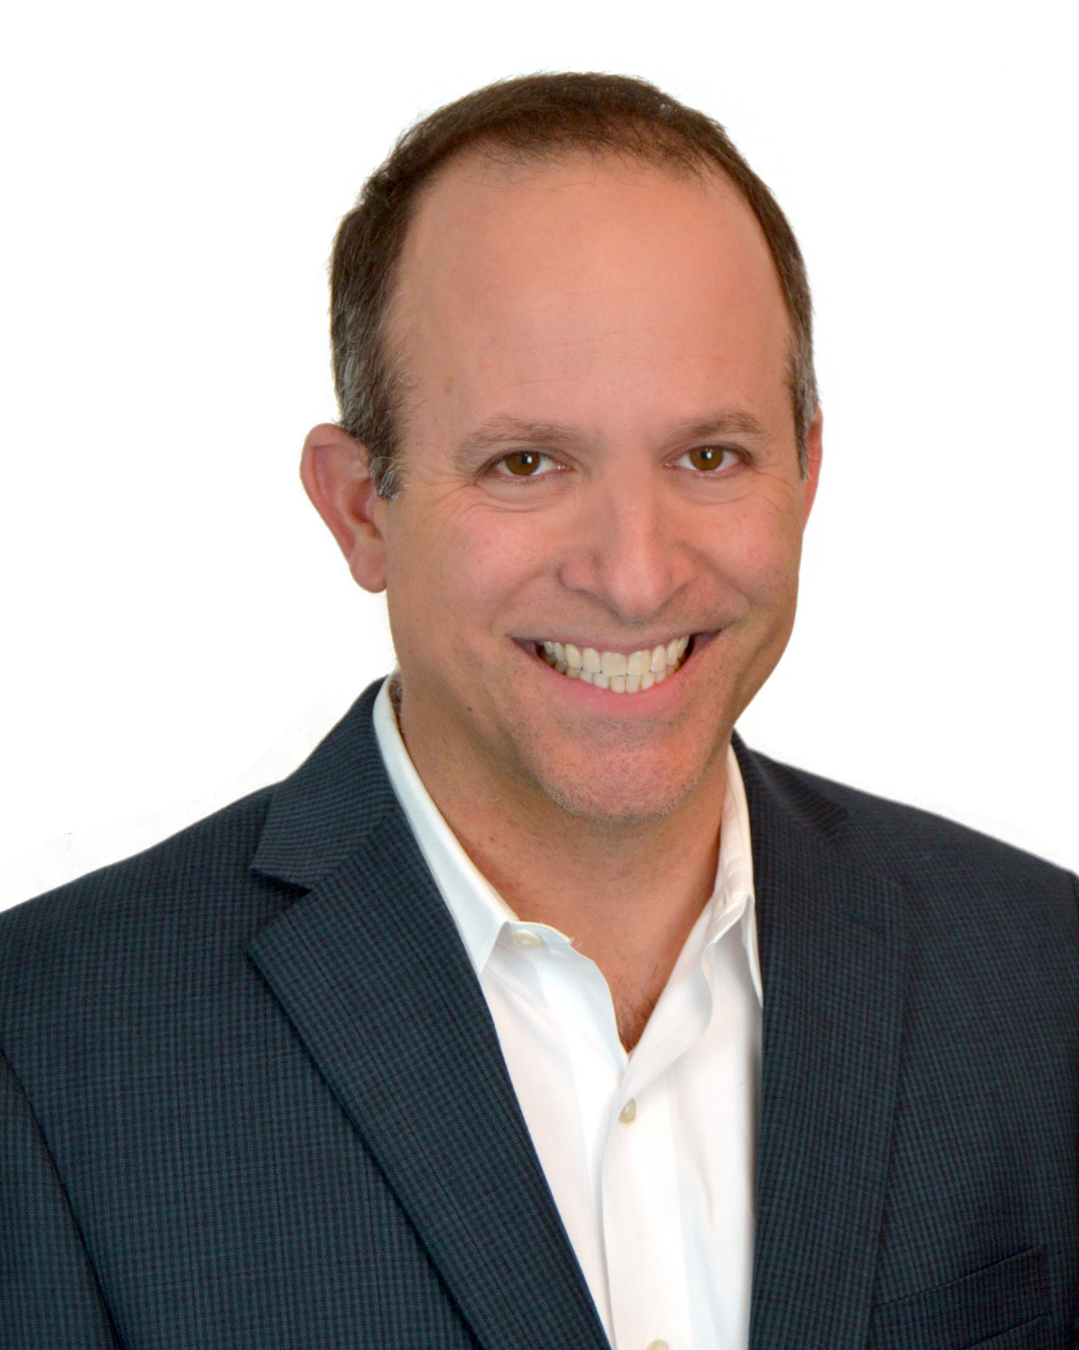
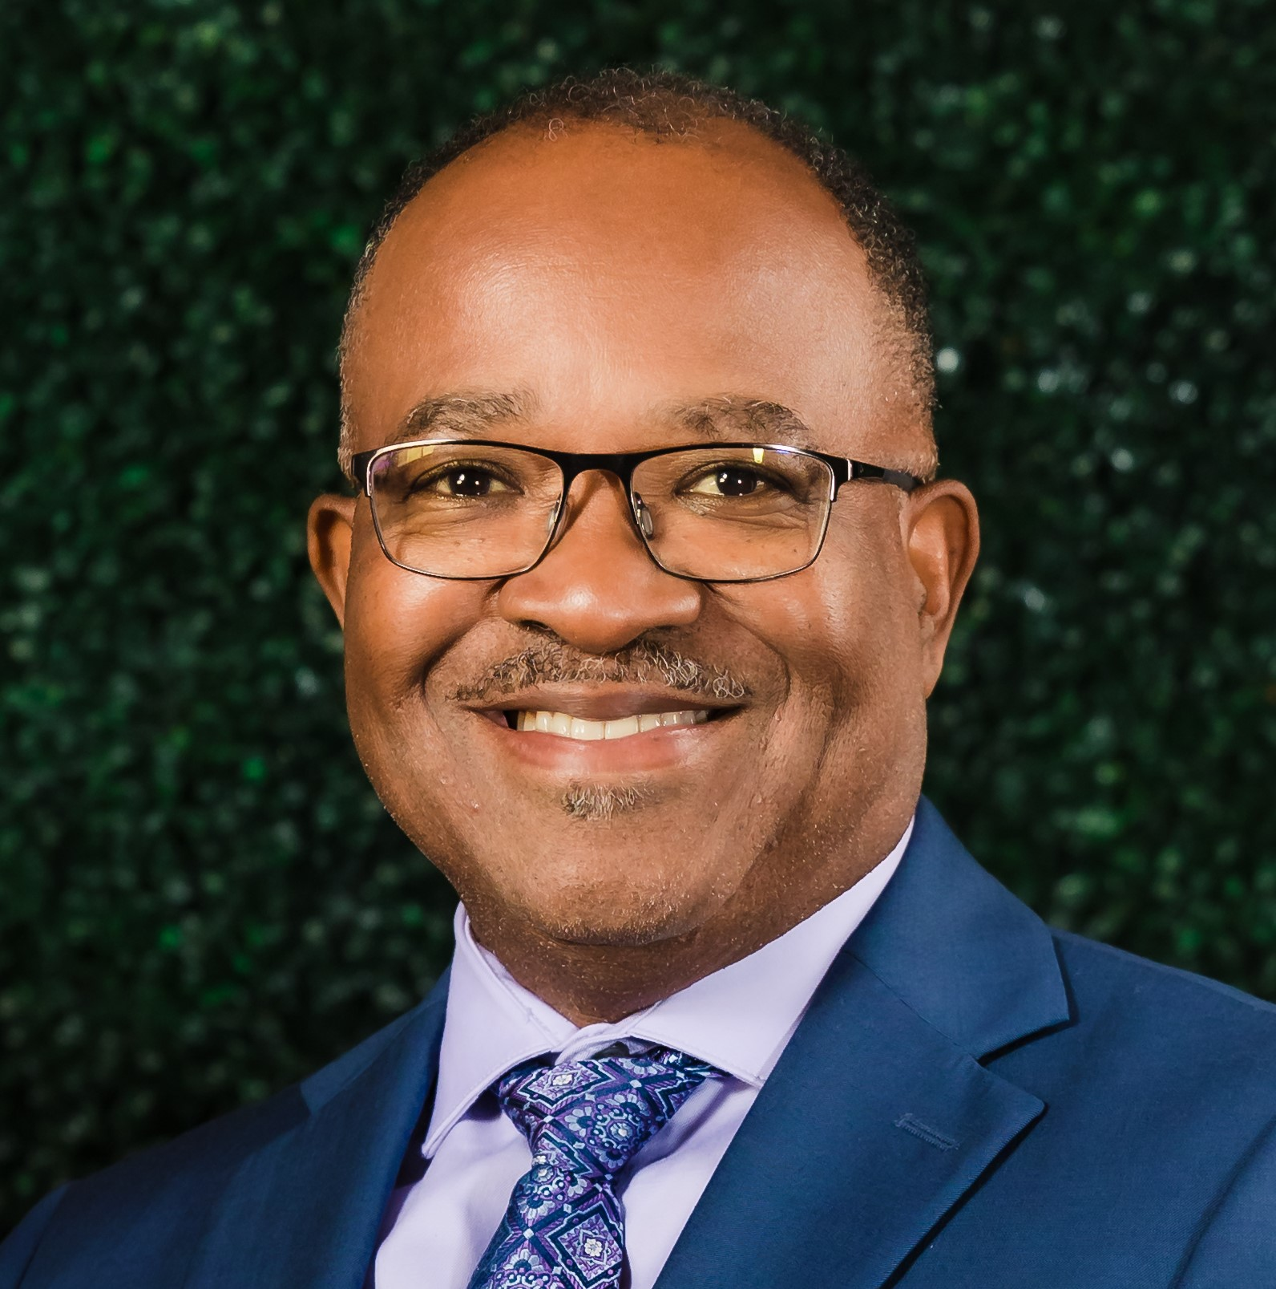
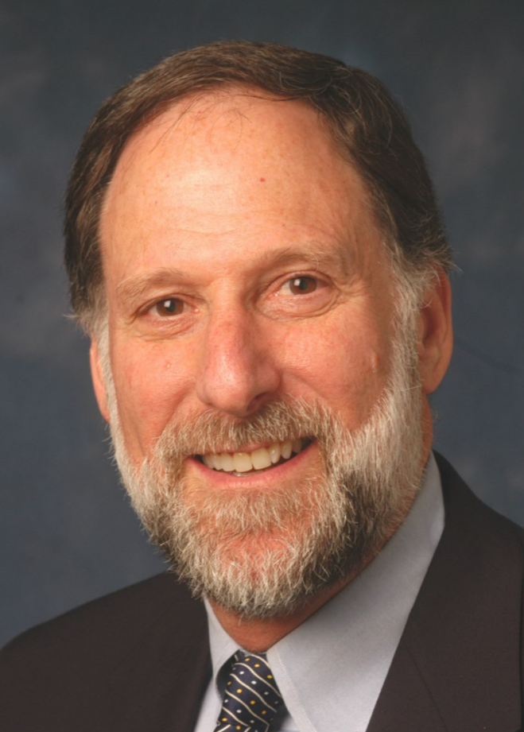
SPSP Webinar Speakers
Larry Bell
BSH Home Appliances
Mark Hickok
Milwaukee Electric Tool
Kenneth Ross
Bowman and Brooke LLP
Jason Hertzberg
Exponent, Inc.

Slide 3
Agenda
Training Call Center personnel
Questions to ask consumers
Reviewing post-sale information
Retrieving product from consumer
Post-sale failure analysis
Decide what it means and what to do
How to document process
Questions
Notes:
KR

Slide 4
Upcoming Webinars
April 19, 2023 – Using Data Analytics for Product Safety
May 17, 2023 – Insurance Company Guidance on Product Safety
June 20, 2023 – International Update
Notes:
KR

Slide 5
For questions after the webinar, email SPSP at info@productsafetyprofessionals.org or contact speakers:
jhertzberg@exponent.com
mark.hickok@milwaukeetool.com
larry.bell@bshg.com
kenrossesq@gmail.com
These slides, a link to a video of this webinar and more material can be accessed at https://www.productsafetyprofessionals.org/webinar-archive.

Slide 6
Thank you for attending!
SPSP 2023 Webinar Series
March 16, 2023
Sponsored by Sedgwick Brand Protection
Notes:
Questions.
KR will ask questions and DM or JB can answer, depending on the question.

